Slide 1
Statistics for Graduate Students: Class #2
Statistical errors: Type I and Type II
Two-sample t tests
Beyond dichotomous inference: Confidence intervals, effect size estimates

Slide 2
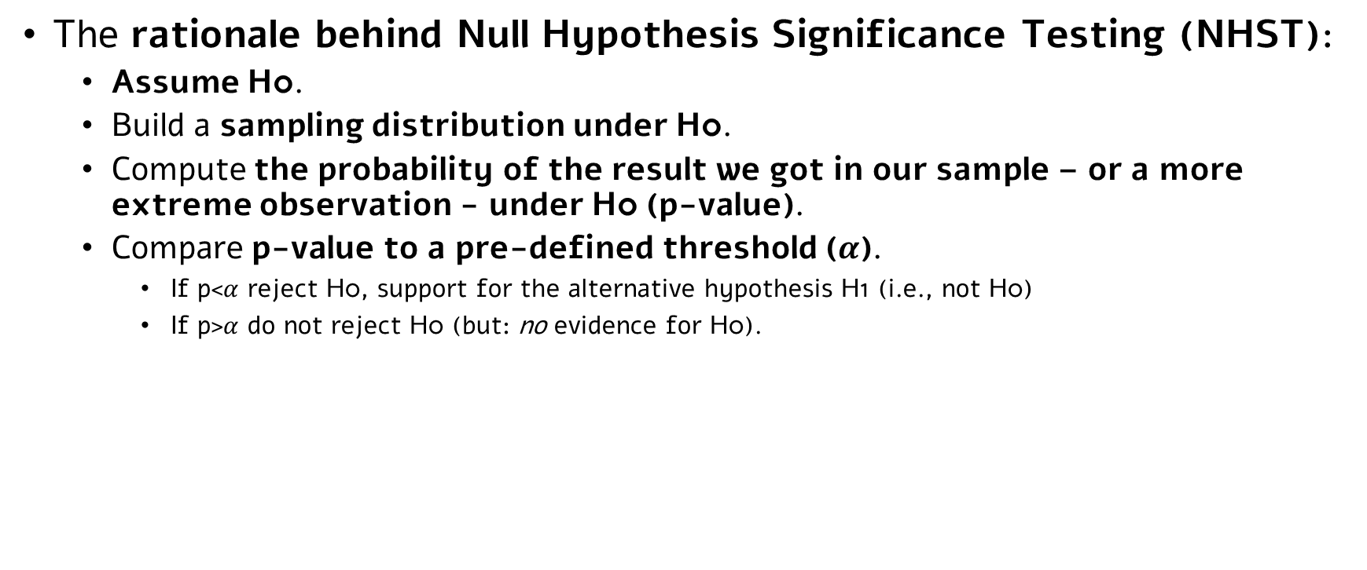
Previously, on Stats for Grad Students…
The rationale behind Null Hypothesis Significance Testing (NHST):
Assume H0.
Build a sampling distribution under H0.
Compute the probability of the result we got in our sample – or a more extreme observation - under H0 (p-value).
Compare p-value to a pre-defined threshold ($α$).
If p<$α$ reject H0, support for the alternative hypothesis H1 (i.e., not H0)
If p>$α$ do not reject H0 (but: no evidence for H0).

Slide 3

Previously, on Stats for Grad Students…
Two very basic statistical tests: One-sample tests.
One-sample = we want to estimate the expected value of one population, and test the hypothesis that it’s larger/smaller/different than a given value.
We estimate the expected value by taking a sample and computing a mean.
If SD/variance of the population is known, we use a one-sample Z test
If SD/variance of the population is unknown, we use a one-sample t test
$$\frac{\overline{x}−μ_{H0}}{{σ_{x}}/{\sqrt{N}}}\sim _{H_{0}}N\left(0, 1\right) → Z_{x}=\frac{\overline{x}−μ_{H0}}{{σ_{x}}/{\sqrt{N}}}$$
$$\frac{\overline{x}−μ_{H0}}{{{\hat{s}}_{x}}/{\sqrt{N}}}\sim _{H_{0}}t_{(n−1)} → t_{n−1}=\frac{\overline{x}−μ_{H0}}{{{\hat{s}}_{x}}/{\sqrt{N}}}$$

Slide 4
Inference Errors Type I & Type II errors

Slide 5
Inference errors
NHST tools are inherently probabilistic.
We compute p(observed result or a more extreme observation | H0) and reject H0 if p(observed result or a more extreme observation | H0) < alpha.
As in any probabilistic decision, NHST by-definition includes some probability for errors.
In fact, a key idea behind NHST is to ‘control’ for error rates.
(yet unfortunately, it doesn’t always happen – more soon…).
Two types of errors: Type I vs. Type II.

Slide 6
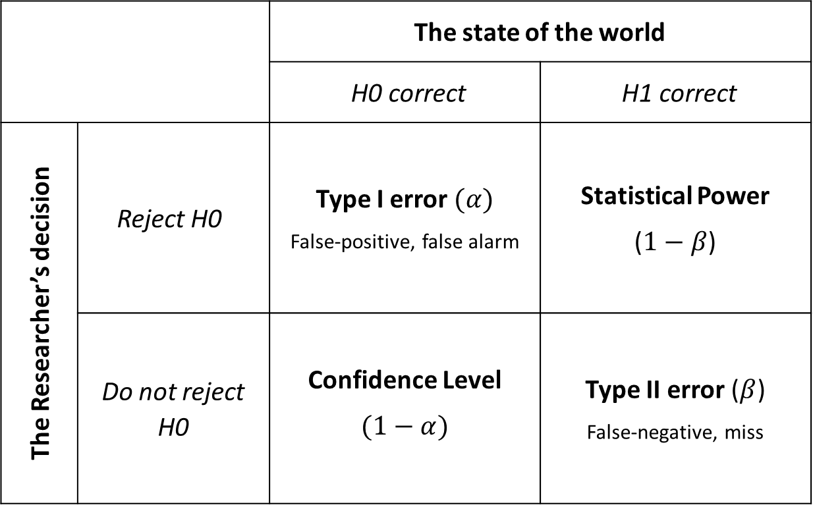
Inference errors
The state of the world
H1 correct | H0 correct
Statistical Power ($1−β$) | Type I error $(α)$ False-positive, false alarm | Reject H0 | The Researcher’s decision
Type II error ($β$) False-negative, miss | Confidence Level $$(1−α)$$ | Do not reject H0

Slide 7
Inference errors
The state of the world
H1 correct | H0 correct
Statistical Power ($1−β$) | Type I error $(α)$ False-positive, false alarm | Reject H0 | The Researcher’s decision
Type II error ($β$) False-negative, miss | Confidence Level $$(1−α)$$ | Do not reject H0

Slide 8
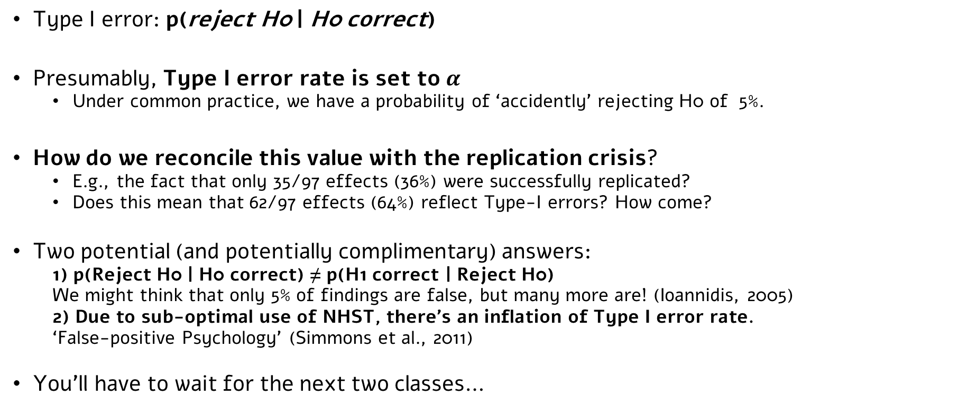
Type I error
Type I error: p(reject H0 | H0 correct)
Presumably, Type I error rate is set to $α$
Under common practice, we have a probability of ‘accidently’ rejecting H0 of 5%.
How do we reconcile this value with the replication crisis?
E.g., the fact that only 35/97 effects (36%) were successfully replicated?
Does this mean that 62/97 effects (64%) reflect Type-I errors? How come?
Two potential (and potentially complimentary) answers:
1) p(Reject H0 | H0 correct) ≠ p(H1 correct | Reject H0)
We might think that only 5% of findings are false, but many more are! (Ioannidis, 2005)
2) Due to sub-optimal use of NHST, there’s an inflation of Type I error rate.
‘False-positive Psychology’ (Simmons et al., 2011)
You’ll have to wait for the next two classes…

Slide 9
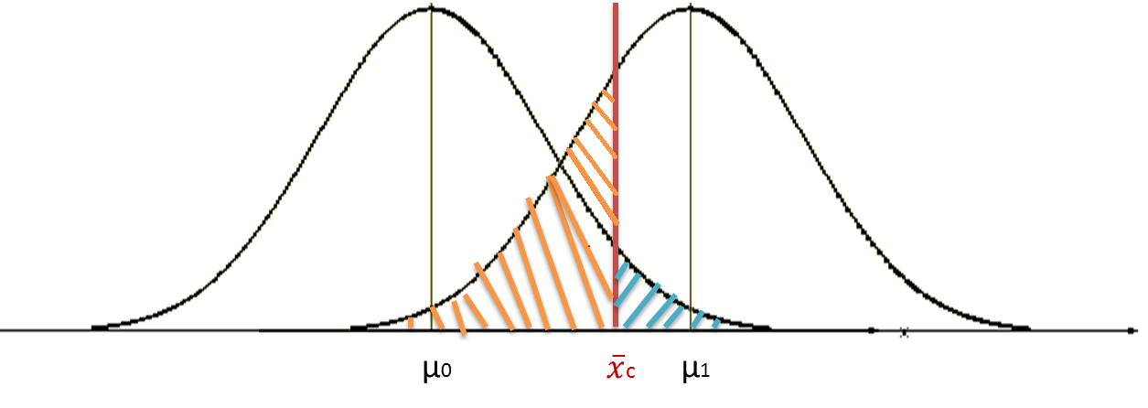
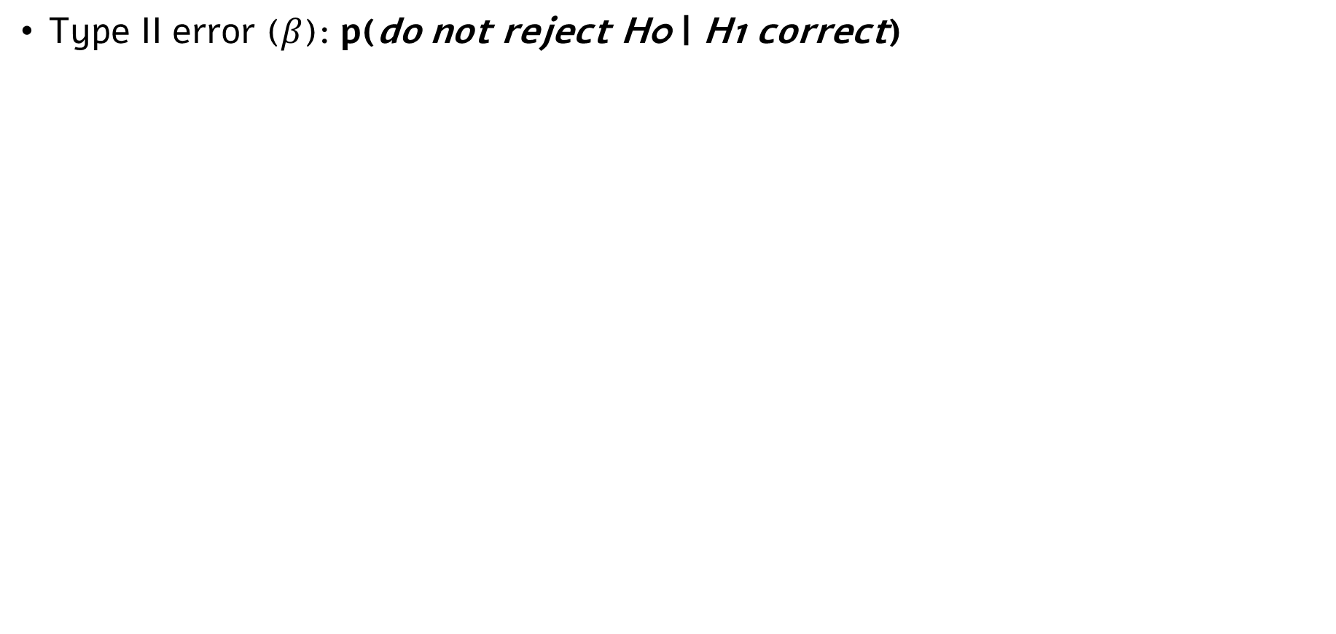


Type II error
Type II error ($β$): p(do not reject H0 | H1 correct)
Value associated with p=0.05
Sampling distribution under H1
Sampling distribution under H0
$$β$$
$$α$$

Slide 10

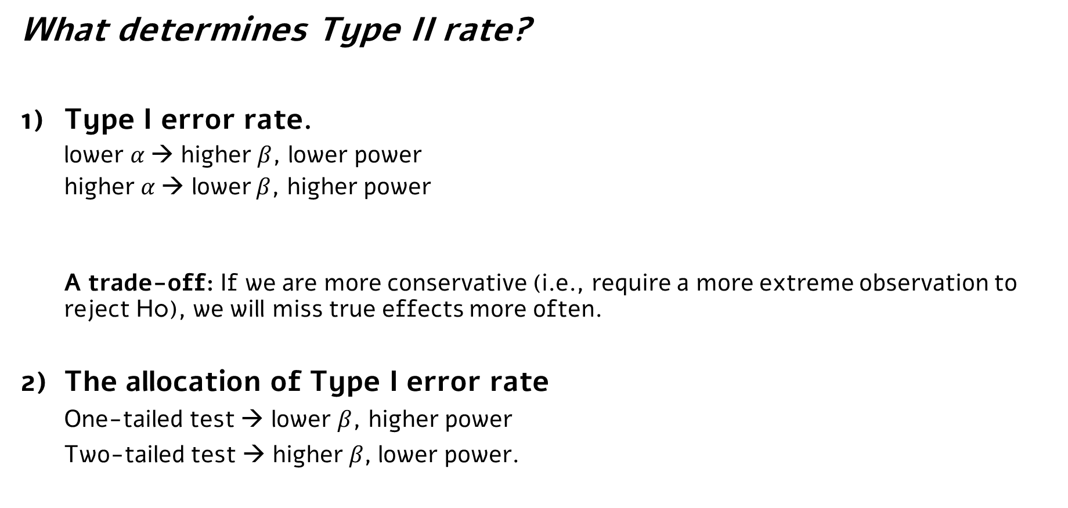
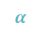
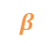
Type II error
$$β$$
$$α$$
What determines Type II rate?
Type I error rate.
lower $α$→ higher $β$, lower power
higher $α$→ lower $β$, higher power
A trade-off: If we are more conservative (i.e., require a more extreme observation to reject H0), we will miss true effects more often.
The allocation of Type I error rate
One-tailed test → lower $β$, higher power
Two-tailed test → higher$β$, lower power.

Slide 11
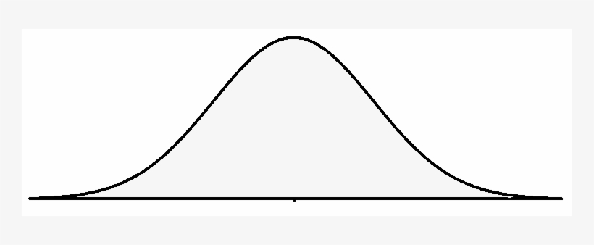

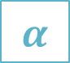
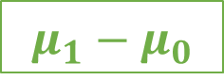
Type II error
$$β$$
$$α$$
What determines Type II rate?
The overlap between sampling distributions under H0 and H1
Generally speaking – more overlap, higher Type II error rate, lower power.
3.1) The distance between their means:
The population effect size: The actual size of the effect in the population.
Larger population effect size, less overlap → Lower Type II error rate, higher power.
Value associated with p=0.05
$$β$$
$$α$$
$$μ_{1}−μ_{0}$$

Slide 12
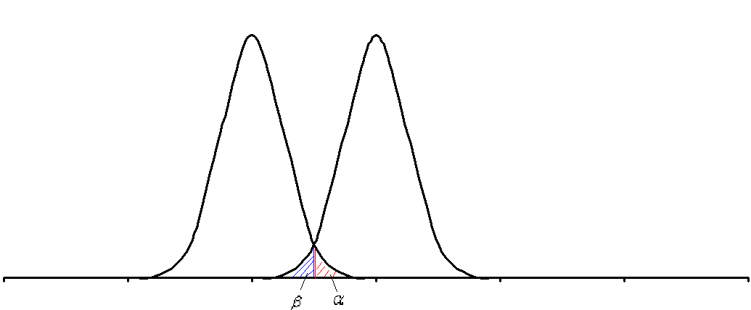
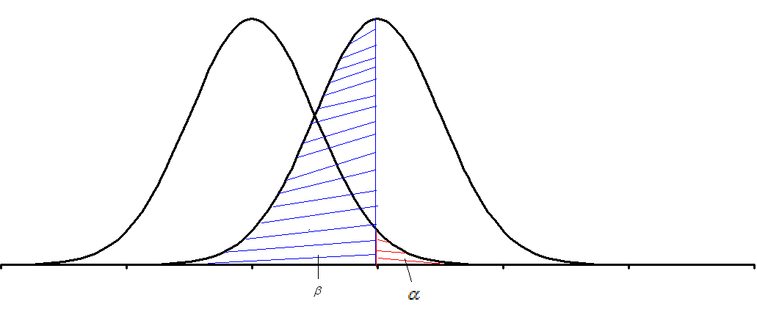
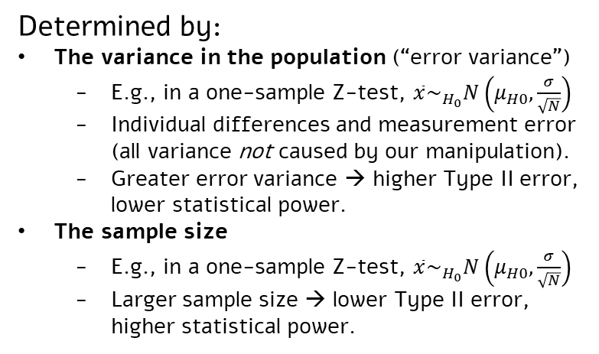
Type II error
$$β$$
$$α$$
What determines Type II rate?
The overlap between sampling distributions under H0 and H1
Generally speaking – more overlap, higher Type II error rate, lower power.
3.2) The variance of the sampling distribution:
Determined by:
The variance in the population (“error variance”)
E.g., in a one-sample Z-test, $\overline{x}\sim _{H_{0}}N\left(μ_{H0}, \frac{σ}{\sqrt{N}}\right)$
Individual differences and measurement error (all variance not caused by our manipulation).
Greater error variance → higher Type II error, lower statistical power.
The sample size
E.g., in a one-sample Z-test, $\overline{x}\sim _{H_{0}}N\left(μ_{H0}, \frac{σ}{\sqrt{N}}\right)$
Larger sample size → lower Type II error, higher statistical power.

Slide 13
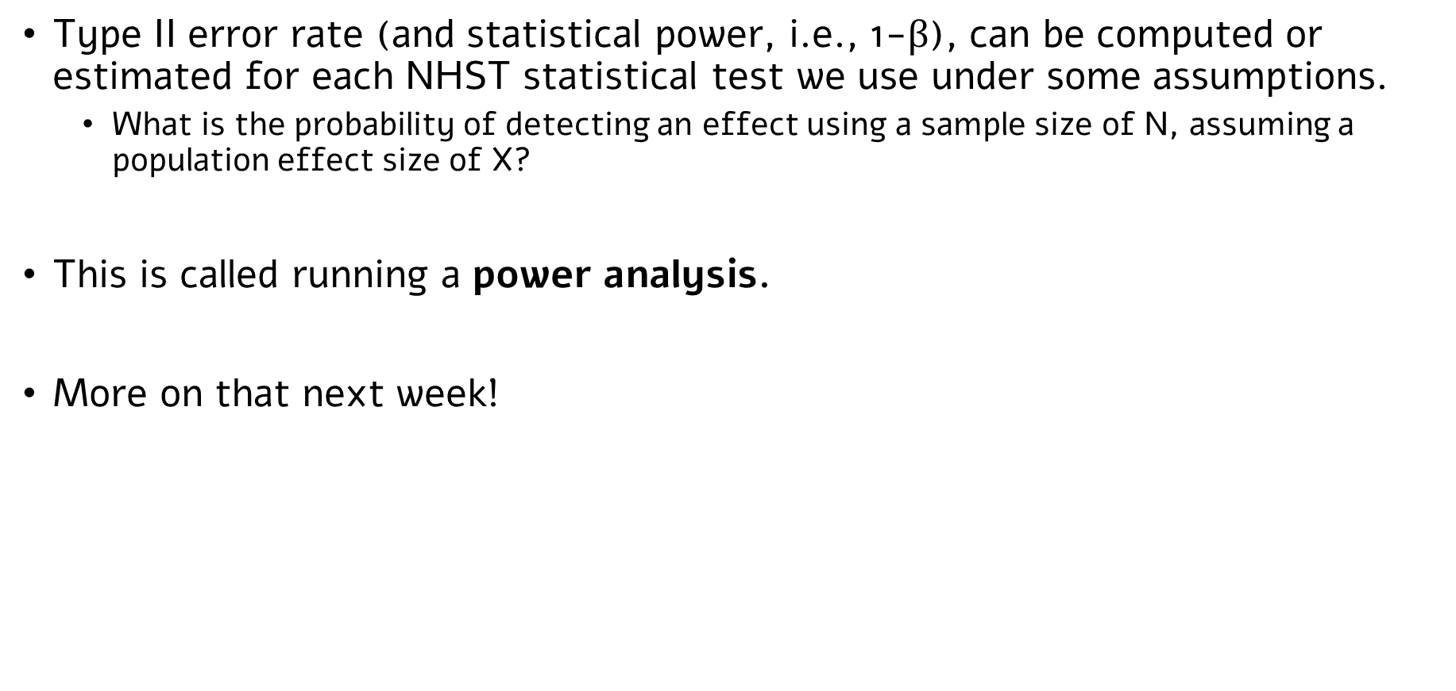
A little bit more formally
Type II error rate (and statistical power, i.e., 1-$β$), can be computed or estimated for each NHST statistical test we use under some assumptions.
What is the probability of detecting an effect using a sample size of N, assuming a population effect size of X?
This is called running a power analysis.
More on that next week!

Slide 14
And a general note
Another factor that can inflate both Type I and Type II errors is violation of assumptions.
NHST procedures control for error rates under a set of assumptions (specific to each statistical test).
E.g., in a one-sample t-test: independent and random sampling, normality.
When assumptions are violated, there’s an increase in error rates.
What is the extent of this increase?
Depends on the assumption and the extent of the violation; depends on the test (some tests are more/less robust to violation of a given assumption).
We can use simulations to estimate the impact of assumption violations on Type I vs. II error rates: Next week, tutorial & homework.

Slide 15
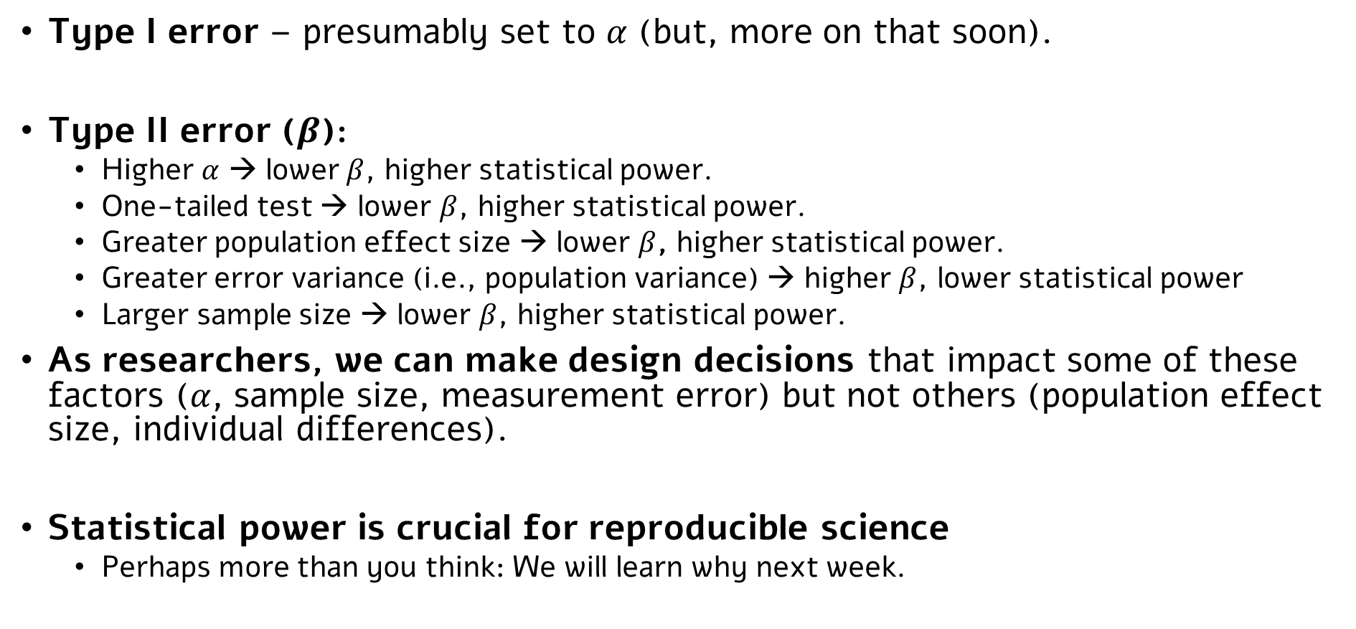
Summary: Type I and Type II errors
Type I error – presumably set to $α$ (but, more on that soon).
Type II error ($β$):
Higher $α$ → lower $β$, higher statistical power.
One-tailed test → lower $β$, higher statistical power.
Greater population effect size → lower $β$, higher statistical power.
Greater error variance (i.e., population variance) → higher $β$, lower statistical power
Larger sample size → lower $β$, higher statistical power.
As researchers, we can make design decisions that impact some of these factors ($α$, sample size, measurement error) but not others (population effect size, individual differences).
Statistical power is crucial for reproducible science
Perhaps more than you think: We will learn why next week.

Slide 16
Two-sample t-test Independent samples

Slide 17
Two-sample tests
One-sample tests are relatively rare.
In many cases, we have more than one group (i.e., one population) of participants (or, more broadly, observations).
E.g.,
Do people who drank caffeine before a test performed better than those who did not?
Do people that took a certain drug fared better in terms of symptoms than a control group?
Do two groups of participants (men vs. women, married vs. single, etc.)differ in some psychological trait?
Do individuals with and without a certain condition differ in their neuronal activity?
…
All these questions can be reframed as an examination of the influence of a categorical independent variable with two levels on a numeric dependent variable.
E.g.,
Yes/no caffeine → test performance
Yes/no drug → symptoms
Sex (male/female) → psychological trait
Psychological condition (present/absent) → neuroimaging measure
In these cases: We will use two-sample tests.

Slide 18
Two-sample tests
Last time, we focused on one-sample tests: Z test (known variance) and a t test (unknown variance).
These two variants also exist in two-sample tests.
We will focus today on a tw0-sample t-test (unknown variance).
The Much more common case.
Extension to a two-sample Z-test is trivial; we’ll mention it in passing.

Slide 19

An example: Statistical learning performance in individuals with dyslexia
Remember the Auditory Statistical Learning task?
Familiarization phase:
bodesa
lemofa
ludegi
ridano
...
Test phase:
Which word belongs to the language?
Each Participant’s score:
Number/Proportion of correctly identified ‘words’ in a series of k 2-AFC trials.
bodesa
vs.
bomogi

Slide 20
An example: Statistical learning performance in individuals with dyslexia
Remember the Auditory Statistical Learning task?
Do individuals with and without dyslexia differ in their auditory statistical learning performance?
Two groups of participants.
One group of individuals with dyslexia (x),
One group of individuals without dyslexia (y).
(For now, let’s assume that the two groups are matched on a variety of other potentially-relevant factors, age, IQ, etc. We will learn what to do when this is not the case later).
A question of real interest!
See Bogaerts et al., 2021, Perspectives in Psych Science, for review

Slide 21
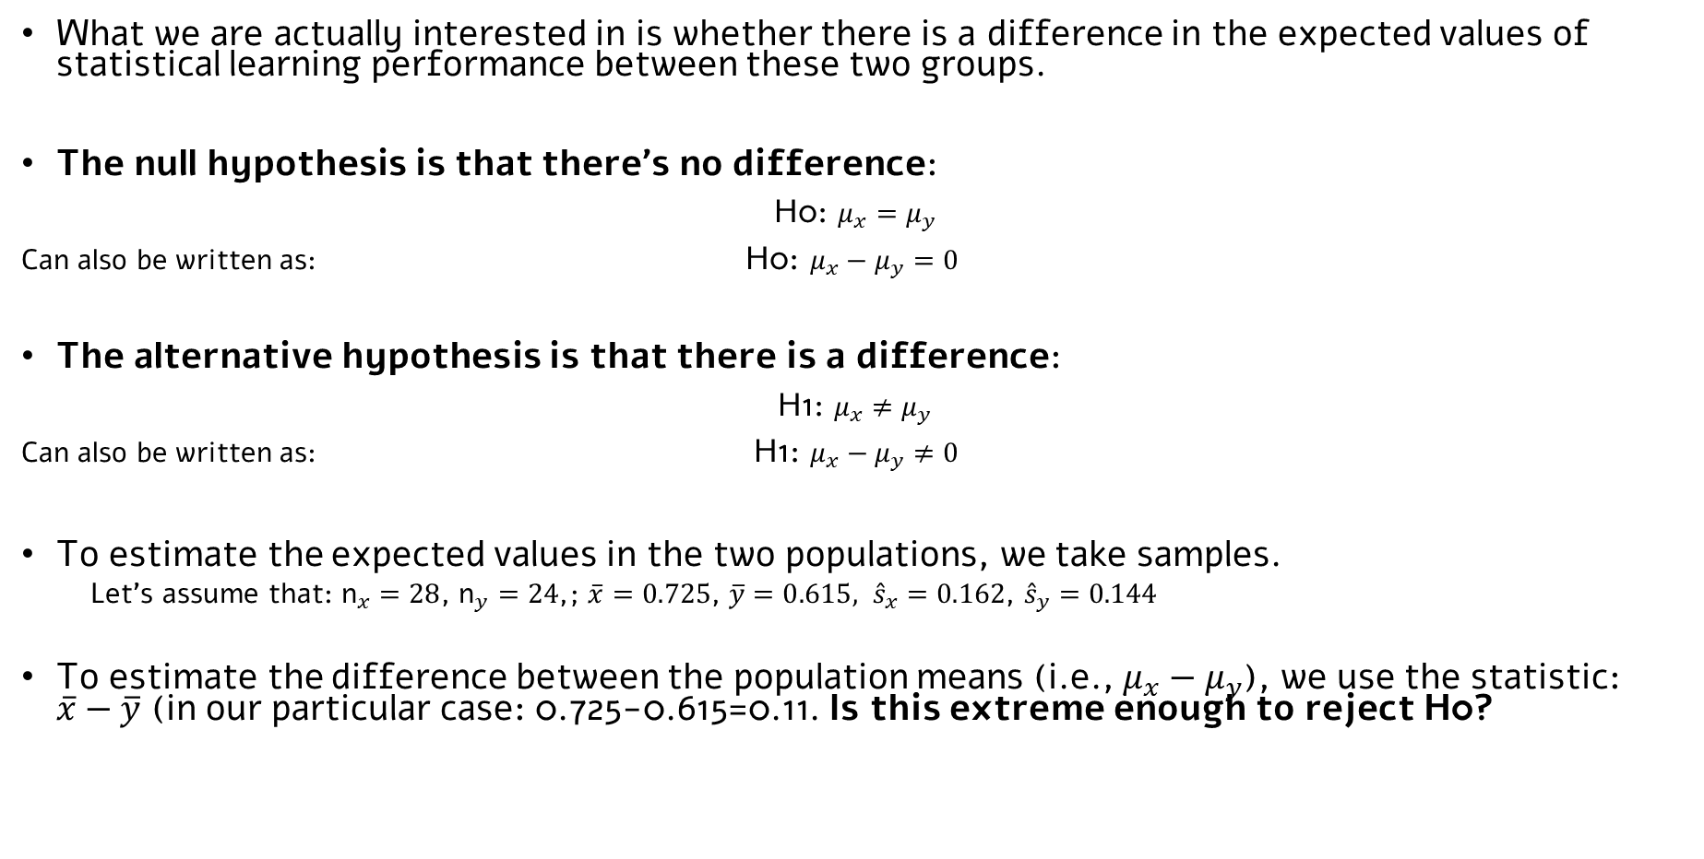
An example: Statistical learning performance in individuals with dyslexia
What we are actually interested in is whether there is a difference in the expected values of statistical learning performance between these two groups.
The null hypothesis is that there’s no difference:
H0: $μ_{x}=μ_{y}$
Can also be written as: H0: $μ_{x}−μ_{y}=0$
The alternative hypothesis is that there is a difference:
H1: $μ_{x}≠μ_{y}$
Can also be written as: H1: $μ_{x}−μ_{y}≠0$
To estimate the expected values in the two populations, we take samples.
Let’s assume that: ${\text{n}}_{x}=28$, ${\text{n}}_{y}=24$,; $\overline{x}=0.725$, $\overline{y}=0.615,$ ${\hat{s}}_{x}=0.162$, ${\hat{s}}_{y}=0.144$
To estimate the difference between the population means (i.e., $μ_{x}−μ_{y}$), we use the statistic: $\overline{x}−\overline{y}$ (in our particular case: 0.725-0.615=0.11. Is this extreme enough to reject H0?
What would be a one-tailed version of a two-sample t test?

Slide 22
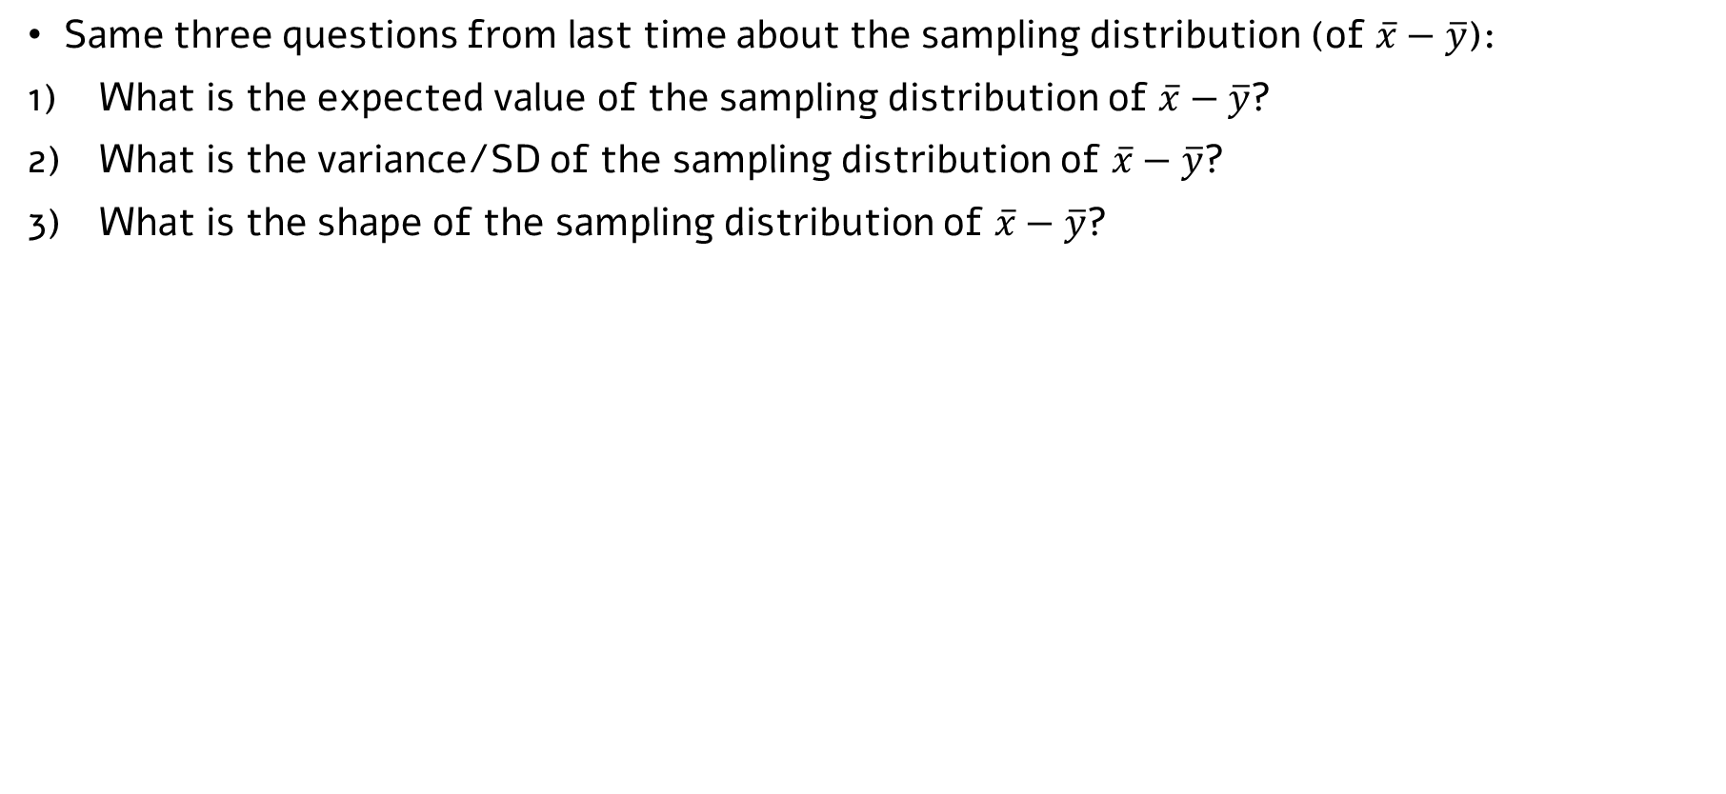
An example: Statistical learning performance in individuals with dyslexia
Same three questions from last time about the sampling distribution (of $\overline{x}−\overline{y}$):
What is the expected value of the sampling distribution of $\overline{x}−\overline{y}$?
What is the variance/SD of the sampling distribution of $\overline{x}−\overline{y}$?
What is the shape of the sampling distribution of $\overline{x}−\overline{y}$?

Slide 23
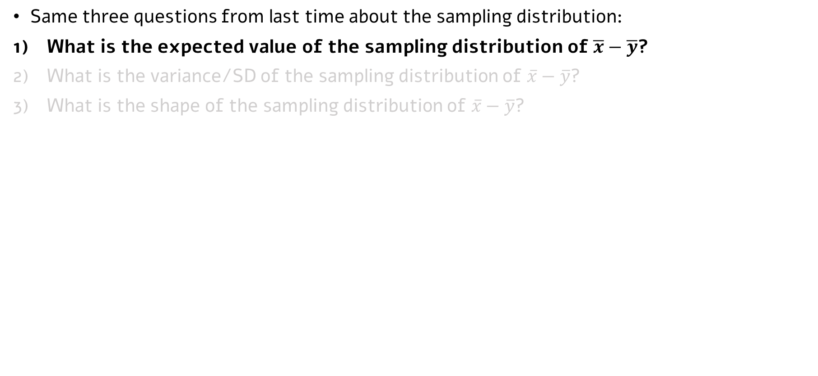
An example: Statistical learning performance in individuals with dyslexia
Same three questions from last time about the sampling distribution:
What is the expected value of the sampling distribution of $\overline{x}−\overline{y}$?
What is the variance/SD of the sampling distribution of $\overline{x}−\overline{y}$?
What is the shape of the sampling distribution of $\overline{x}−\overline{y}$?
$$E\left(\overline{x}−\overline{y}\right)=E\left(x\right)−E\left(y\right)=μ_{x}−μ_{y}$$
Same math as last time.
[Otherwise, we wouldn’t use it as a statistic...]

Slide 24
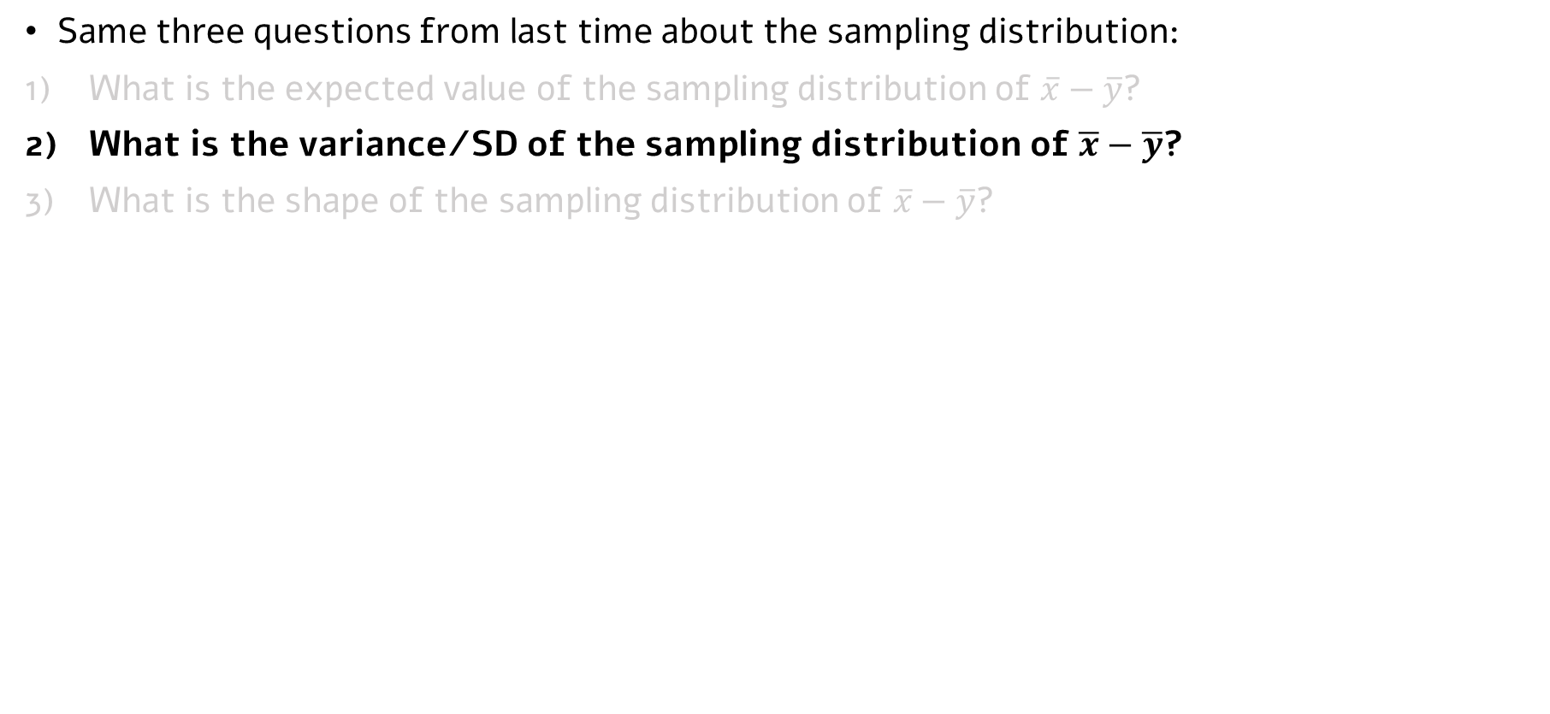
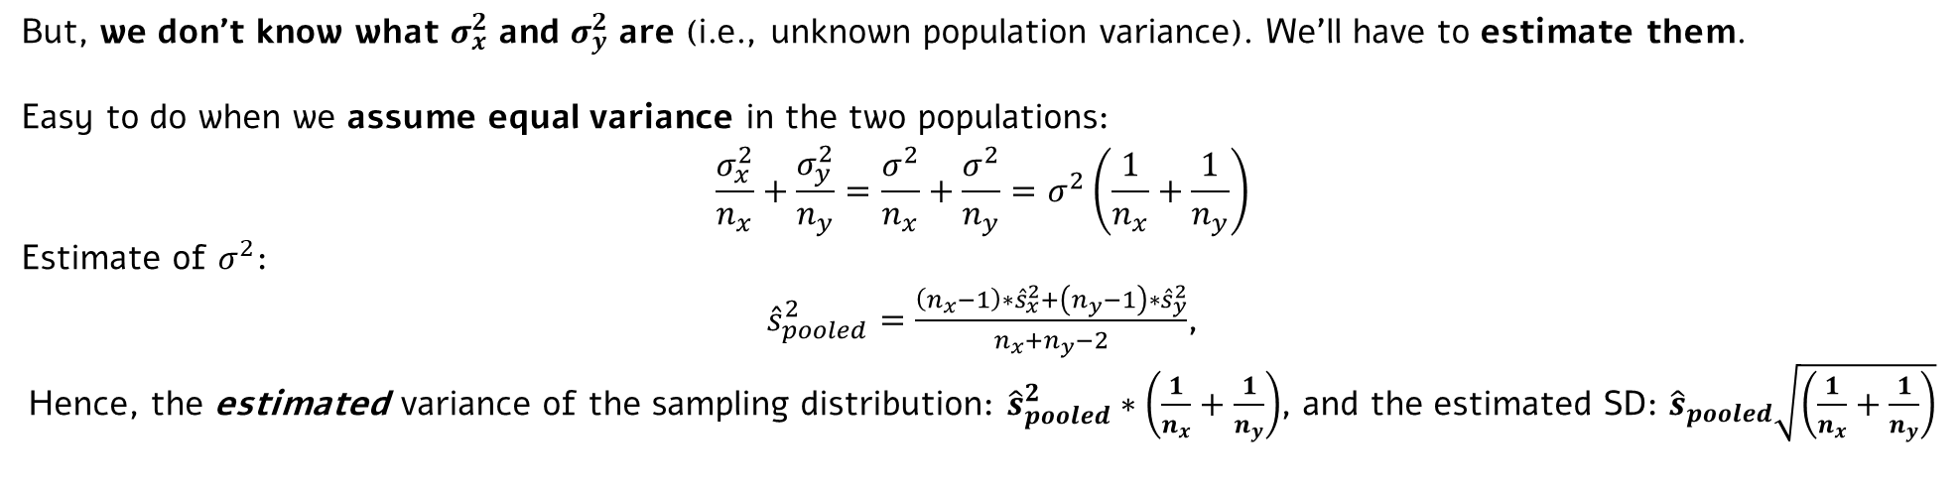
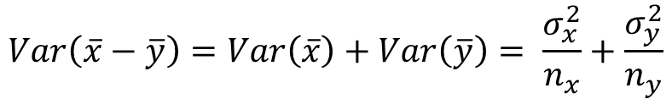
An example: Statistical learning performance in individuals with dyslexia
Same three questions from last time about the sampling distribution:
What is the expected value of the sampling distribution of $\overline{x}−\overline{y}$?
What is the variance/SD of the sampling distribution of $\overline{x}−\overline{y}$?
What is the shape of the sampling distribution of $\overline{x}−\overline{y}$?
$$Var\left(\overline{x}−\overline{y}\right)=Var\left(\overline{x}\right)+Var\left(\overline{y}\right)= \frac{σ_{x}^{2}}{n_{x}}+\frac{σ_{y}^{2}}{n_{y}}$$
(Again, similar math…)
But, we don’t know what $σ_{x}^{2}$ and $σ_{y}^{2}$ are (i.e., unknown population variance). We’ll have to estimate them.
Easy to do when we assume equal variance in the two populations:
$$\frac{σ_{x}^{2}}{n_{x}}+\frac{σ_{y}^{2}}{n_{y}}=\frac{σ^{2}}{n_{x}}+\frac{σ^{2}}{n_{y}}=σ^{2}\left(\frac{1}{n_{x}}+\frac{1}{n_{y}}\right)$$
Estimate of $σ^{2}$:
${\hat{s}}_{pooled}^{2}=\frac{\left(n_{x}−1\right)∗{\hat{s}}_{x}^{2}+\left(n_{y}−1\right)∗{\hat{s}}_{y}^{2}}{n_{x}+n_{y}−2}$,
Hence, the estimated variance of the sampling distribution: ${\hat{s}}_{pooled}^{2}∗\left(\frac{1}{n_{x}}+\frac{1}{n_{y}}\right)$, and the estimated SD: ${\hat{s}}_{pooled}\sqrt{\left(\frac{1}{n_{x}}+\frac{1}{n_{y}}\right)}$
Keep in mind the equal variance assumption…

Slide 25
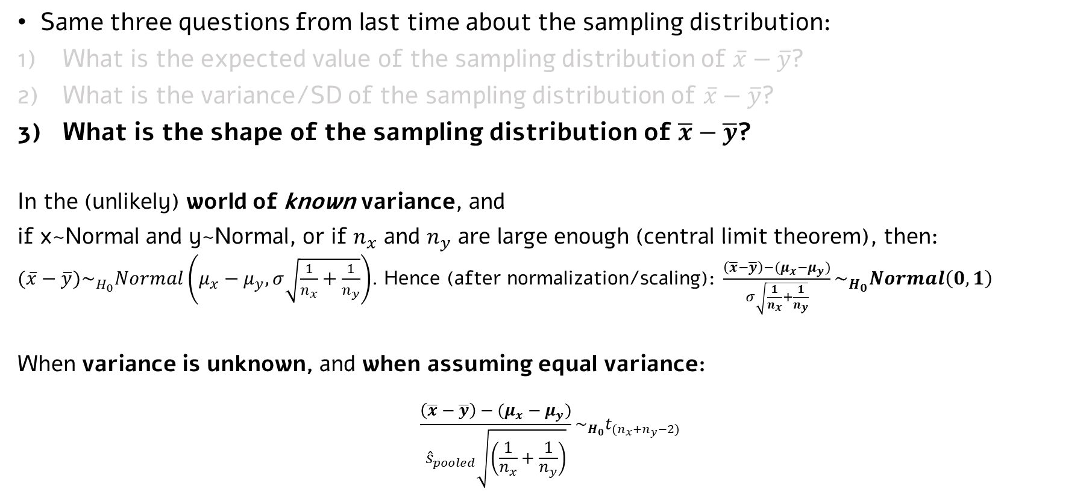
An example: Statistical learning performance in individuals with dyslexia
Same three questions from last time about the sampling distribution:
What is the expected value of the sampling distribution of $\overline{x}−\overline{y}$?
What is the variance/SD of the sampling distribution of $\overline{x}−\overline{y}$?
What is the shape of the sampling distribution of $\overline{x}−\overline{y}$?
In the (unlikely) world of known variance, and
if x~Normal and y~Normal, or if $n_{x}$ and $n_{y}$ are large enough (central limit theorem), then:
$(\overline{x}−\overline{y})\sim _{H_{0}}Normal\left(μ_{x}−μ_{y},σ\sqrt{\frac{1}{n_{x}}+\frac{1}{n_{y}}}\right)$. Hence (after normalization/scaling): $\frac{\left(\overline{x}−\overline{y}\right)−(μ_{x}−μ_{y})}{σ\sqrt{\frac{1}{n_{x}}+\frac{1}{n_{y}}}}\sim _{H_{0}}Normal\left(0,1\right)$
When variance is unknown, and when assuming equal variance:
$$\frac{\left(\overline{x}−\overline{y}\right)−(μ_{x}−μ_{y})}{{\hat{s}}_{pooled}\sqrt{\left(\frac{1}{n_{x}}+\frac{1}{n_{y}}\right)}}\sim _{H_{0}}t_{{(n}_{x}+n_{y}−2)}$$

Slide 26
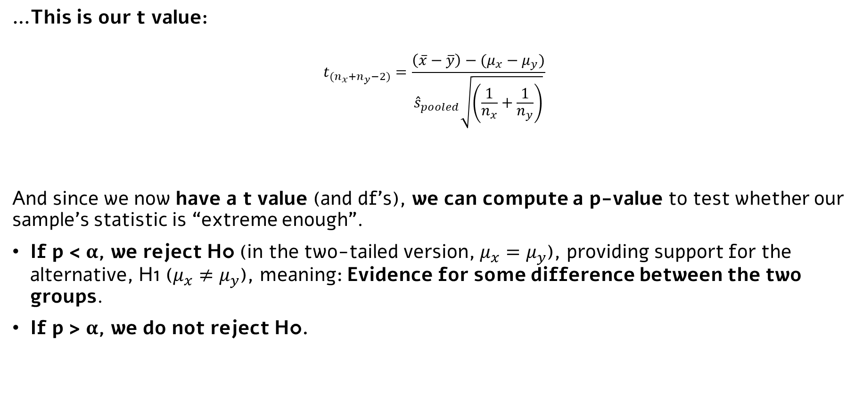
Two-sample t-test (the bottom line)
…This is our t value:
$$t_{{(n}_{x}+n_{y}−2)}=\frac{\left(\overline{x}−\overline{y}\right)−(μ_{x}−μ_{y})}{{\hat{s}}_{pooled}\sqrt{\left(\frac{1}{n_{x}}+\frac{1}{n_{y}}\right)}}$$
And since we now have a t value (and df’s), we can compute a p-value to test whether our sample’s statistic is “extreme enough”.
If p < $α$, we reject H0 (in the two-tailed version, $μ_{x}=μ_{y}$), providing support for the alternative, H1 ($μ_{x}≠μ_{y}$), meaning: Evidence for some difference between the two groups.
If p > $α$, we do not reject H0.

Slide 27
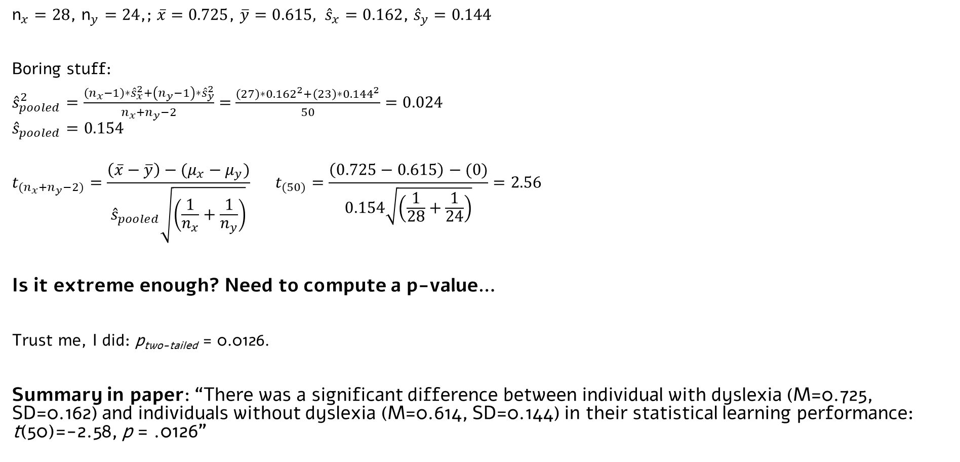
Back to our example…
${\text{n}}_{x}=28$, ${\text{n}}_{y}=24$,; $\overline{x}=0.725$, $\overline{y}=0.615,$ ${\hat{s}}_{x}=0.162$, ${\hat{s}}_{y}=0.144$
Boring stuff:
${\hat{s}}_{pooled}^{2}=\frac{\left(n_{x}−1\right)∗{\hat{s}}_{x}^{2}+\left(n_{y}−1\right)∗{\hat{s}}_{y}^{2}}{n_{x}+n_{y}−2}=$ $\frac{\left(27\right)∗{0.162}^{2}+\left(23\right)∗{0.144}^{2}}{50}=0.024$
$${\hat{s}}_{pooled}=0.154$$
$$t_{{(n}_{x}+n_{y}−2)}=\frac{\left(\overline{x}−\overline{y}\right)−(μ_{x}−μ_{y})}{{\hat{s}}_{pooled}\sqrt{\left(\frac{1}{n_{x}}+\frac{1}{n_{y}}\right)}} t_{(50)}=\frac{\left(0.725−0.615\right)−(0)}{0.154\sqrt{\left(\frac{1}{28}+\frac{1}{24}\right)}}=2.56$$
Is it extreme enough? Need to compute a p-value…
Trust me, I did: p_{two-tailed} = 0.0126.
Summary in paper: “There was a significant difference between individual with dyslexia (M=0.725, SD=0.162) and individuals without dyslexia (M=0.614, SD=0.144) in their statistical learning performance: t(50)=-2.58, p = .0126”

Slide 28
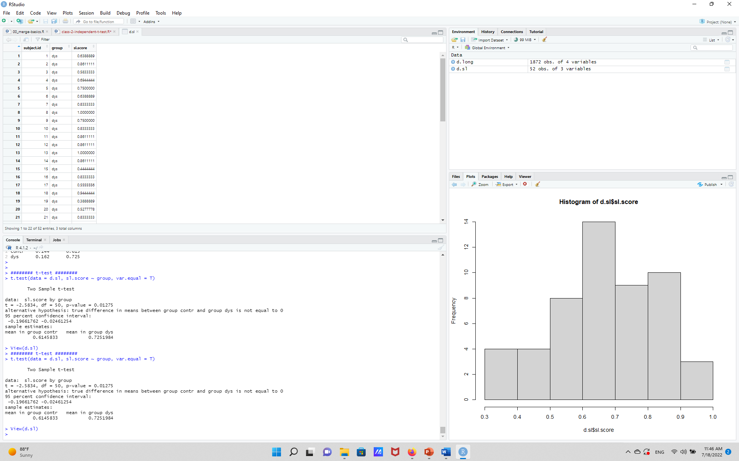
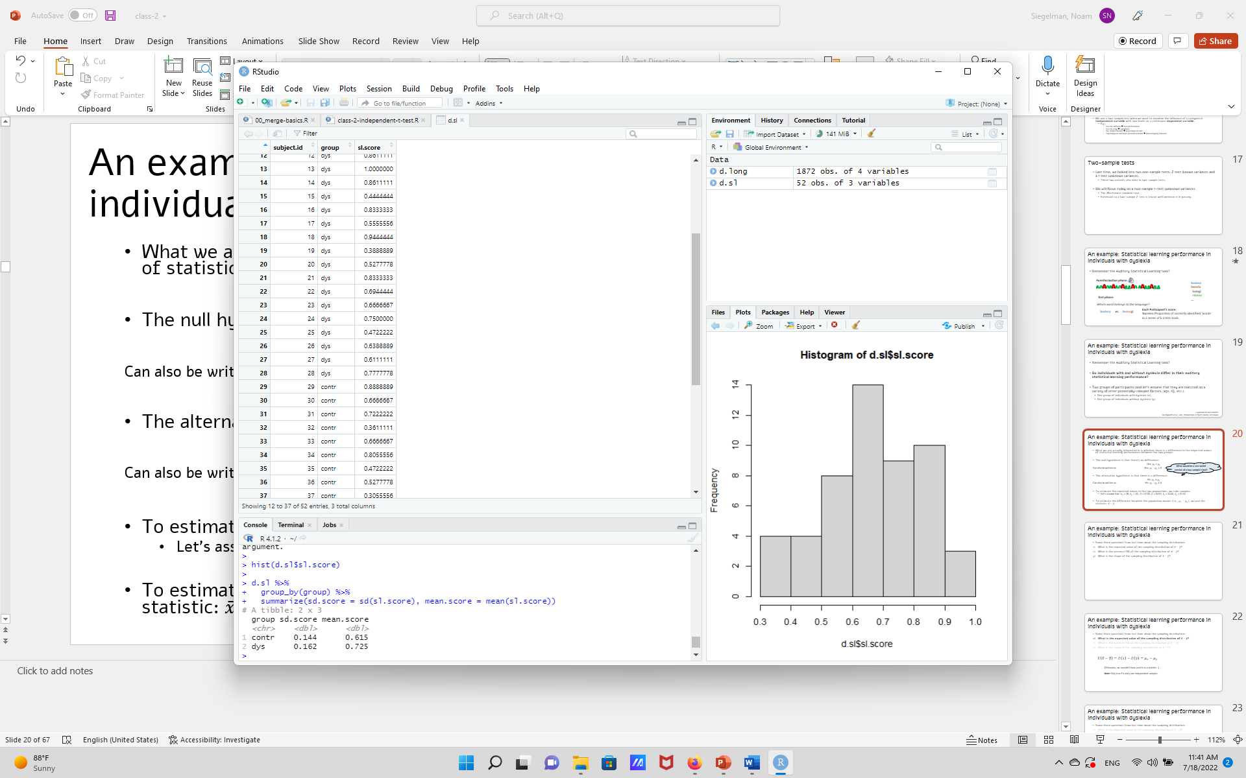
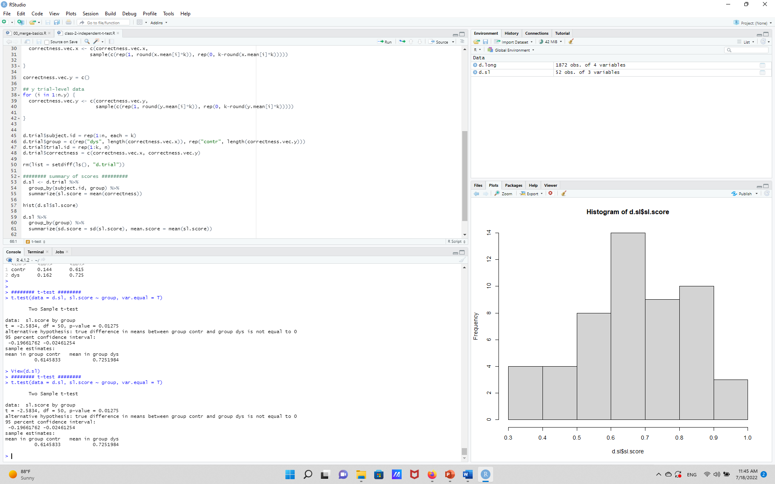

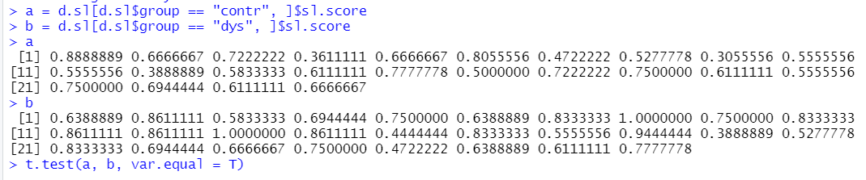
Two-sample t-test in R
Bring the data to a format where each participant is in one row in a data frame.
Dependent variable saved in one variable (as a numeric).
Independent variable saved in another (as a factor).
Then, one line magic!
A more general syntax (compare two vectors; e.g., for simulations)
Look at ?t.test and check: How to run a one-tailed test?

Slide 29
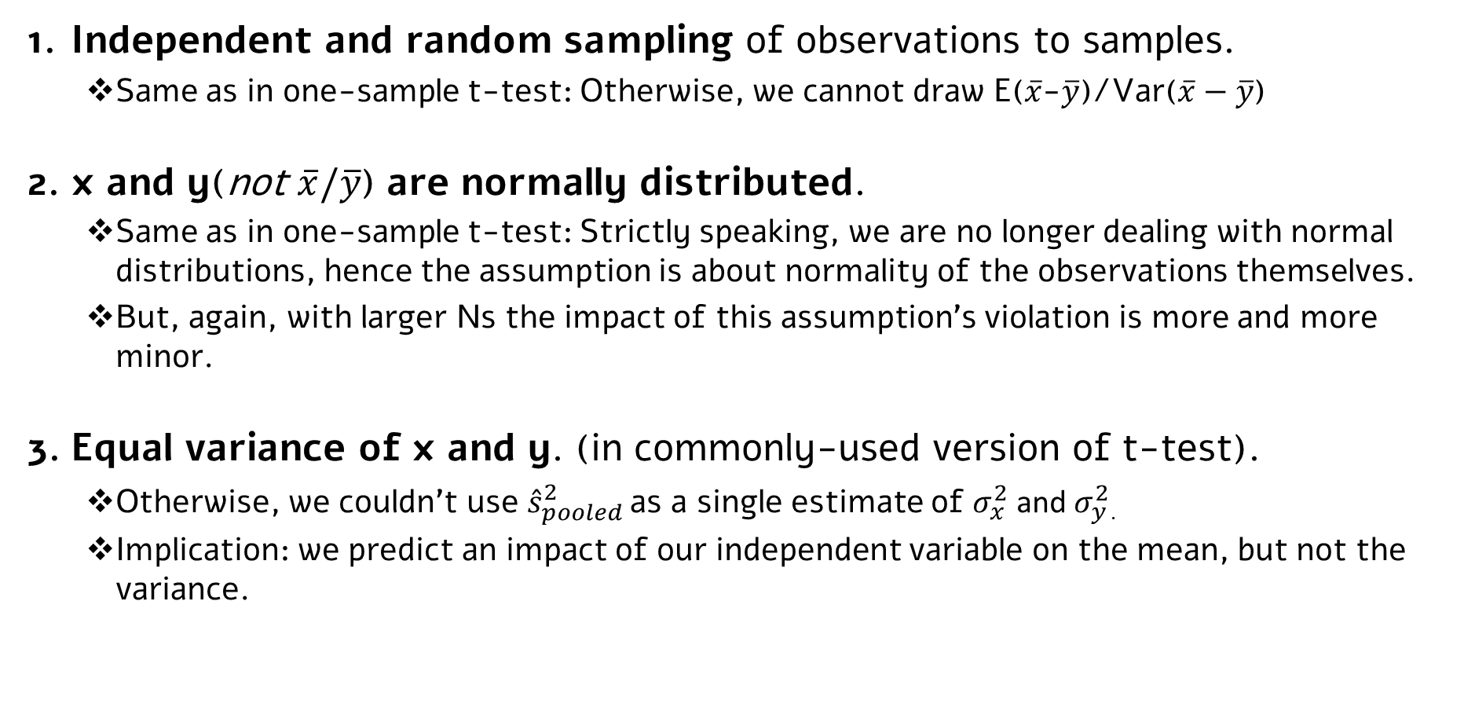
Two sample t-test: assumptions
Independent and random sampling of observations to samples.
Same as in one-sample t-test: Otherwise, we cannot draw E($\overline{x}$-$\overline{y}$)/Var($\overline{x}−\overline{y}$)
x and y(not $\overline{x}/\overline{y}$) are normally distributed.
Same as in one-sample t-test: Strictly speaking, we are no longer dealing with normal distributions, hence the assumption is about normality of the observations themselves.
But, again, with larger Ns the impact of this assumption’s violation is more and more minor.
Equal variance of x and y. (in commonly-used version of t-test).
Otherwise, we couldn’t use ${\hat{s}}_{pooled}^{2}$ as a single estimate of $σ_{x}^{2}$ and $σ_{y}^{2}$.
Implication: we predict an impact of our independent variable on the mean, but not the variance.

Slide 30



We sometimes (often?) violate these assumptions…
Even in our statistical learning example…
Independent and random sampling
x and y are normally distributed.
Equal variance of x and y.
How bad is a violation(s)? To what extent it inflates error rates?
Simulations…
We’ll learn complimentary tools as we go along, starting… Now!
(depends on the design, of course…)
But also: assumption probably does not fully hold (e.g., cannot have proportion > 1, so some assymtery expected)
In 2-AFC trials (i.e., binomial distribution) variance and means covary (Var=N*p*q), especially around edges

Slide 31
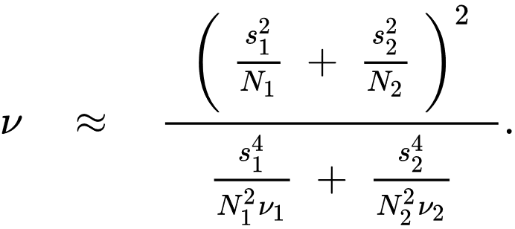
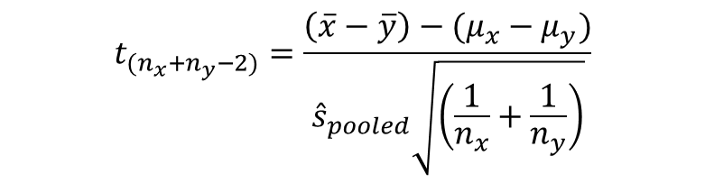
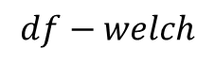
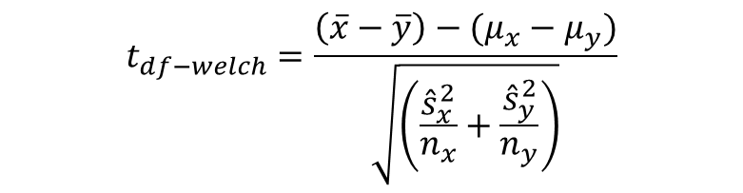
Two-sample t-test for unequal variances: Welch’s t-test
Developed by Bernard Lewis Welch.
Instead of pooling SDs, use SD of each sample (x and y), along with an approximation of the resulting t distribution’s df’s.
Equal variance t-test
Welch’s t-test
$$t_{{(n}_{x}+n_{y}−2)}=\frac{\left(\overline{x}−\overline{y}\right)−(μ_{x}−μ_{y})}{{\hat{s}}_{pooled}\sqrt{\left(\frac{1}{n_{x}}+\frac{1}{n_{y}}\right)}}$$
$$t_{df−welch}=\frac{\left(\overline{x}−\overline{y}\right)−(μ_{x}−μ_{y})}{\sqrt{\left(\frac{{\hat{s}}_{x}^{2}}{n_{x}}+\frac{{\hat{s}}_{y}^{2}}{n_{y}}\right)}}$$
Where:
$$df−welch$$
(for those interested: Sub-script 1 and 2 here stand for x and y, respectively; and v refers to df. Math requires too much algebra ☺)

Slide 32
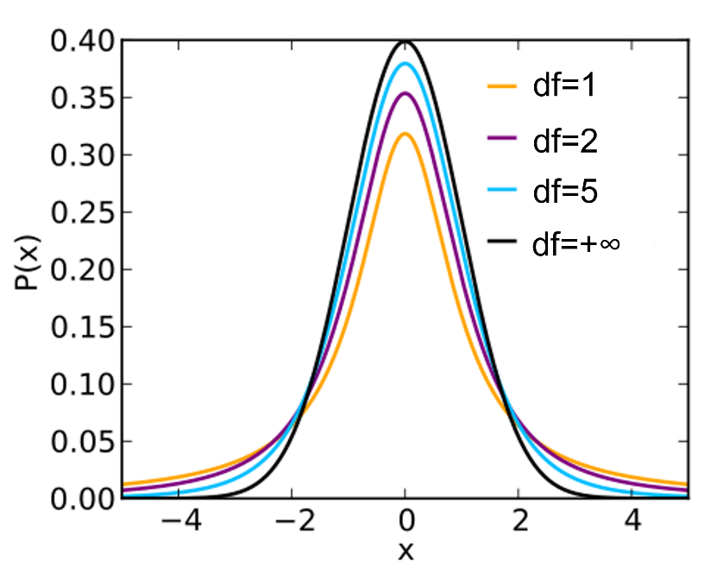
Two-sample t-test for unequal variance: Welch’s t-test
Intuition:
If the two samples have the same standard deviations, Welch’s df will be the same as the equal-variance t-test.
When the SDs in the samples are different, Welch’s df will be smaller than the equal-variance t-test.
Note that in a sample (with a finite N), even if the population variances are equal, there will be some difference between samples’ SDs. Hence, practically, df_{Welch} < df_{equal-var}
Refresher:

Slide 33
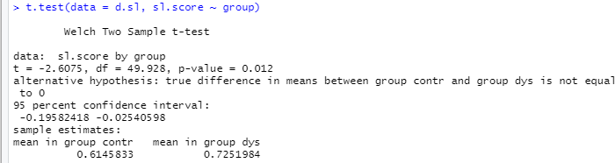
Two-sample t-test for unequal variance: Welch’s t-test
Why not to always use a Welch’s t-test?
Well, some people say you actually should ☺
See Daniel Lakens’ blog post (and paper): http://daniellakens.blogspot.com/2015/01/always-use-welchs-t-test-instead-of.html
R people (implicitly) support that: Default of t-test() function is a Welch’s t-test
The common take: Use it when you have a good reason to not assume equal variance
Otherwise, you are going to “pay” with df’s.
Price is reflected in increased Type II error (less df’s → wider t distribution → need more extreme value to reject H0).
(Plus, sometimes just use alternative tests with less assumptions (to be continued…)

Slide 34
Paired sample t-test

Slide 35
Paired-sample t-test
So far, x’s and y’s were independent of each other, two distinct populations.
That’s not always true. Two common cases:
A design where we know samples are dependent.
E.g., testing for the Flynn Effect (i.e., IQ increases over generations), we may sample pairs of parents and their children.
A within-subject design, where we measure the dependent variable under two levels of the independent variable in one group of participants.
Measure test performance before and after a manipulation.
E.g., Do people with ADHD show improved attention abilities when taking a drug compared to when not taking it (e.g., in separate testing days)?
Measure the same dependent variable in different experimental conditions.
E.g., RT in congruent vs. incongruent conditions?
E.g., RTs for nouns vs. verbs in a reading task?
E.g., do redheads recognize words related to red objects in a different speed than non-red objects?

Slide 36
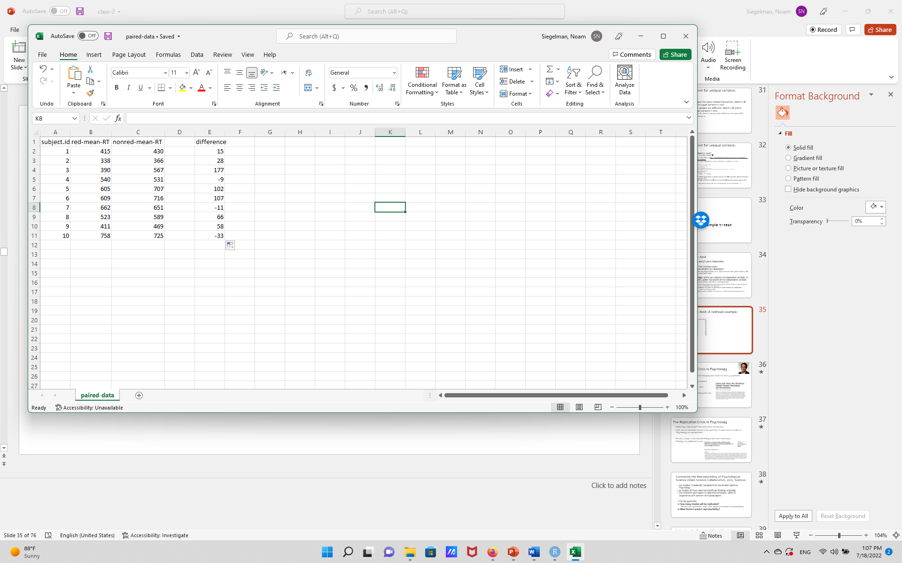

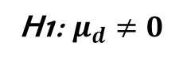
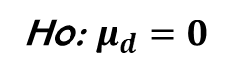
Paired-sample t test: A redhead example
The paired t-test trick:
x
y
d=x-y
H0: $μ_{d}=0$
H1: $μ_{d}≠0$
$$t_{(n−1)}=\frac{\overline{d}−μ_{H0}}{{{\hat{s}}_{d}}/{\sqrt{N}}}$$
Now, simply perform a one-sample t-test on the difference…

Slide 37
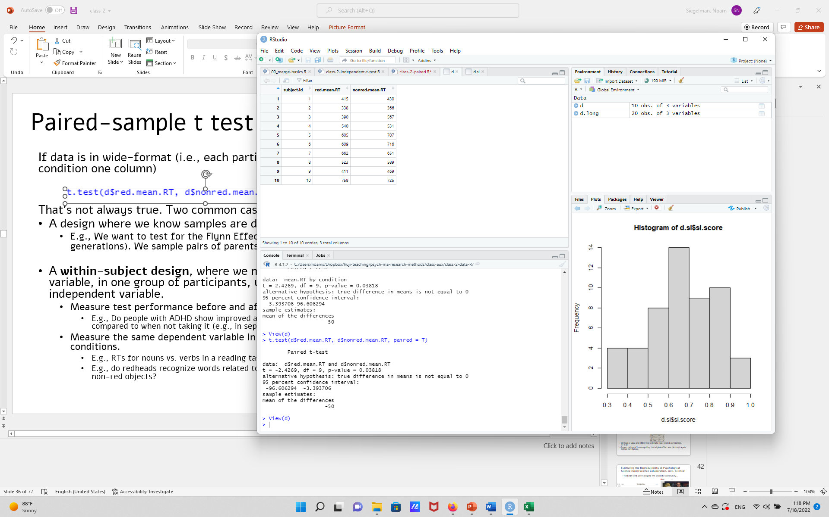
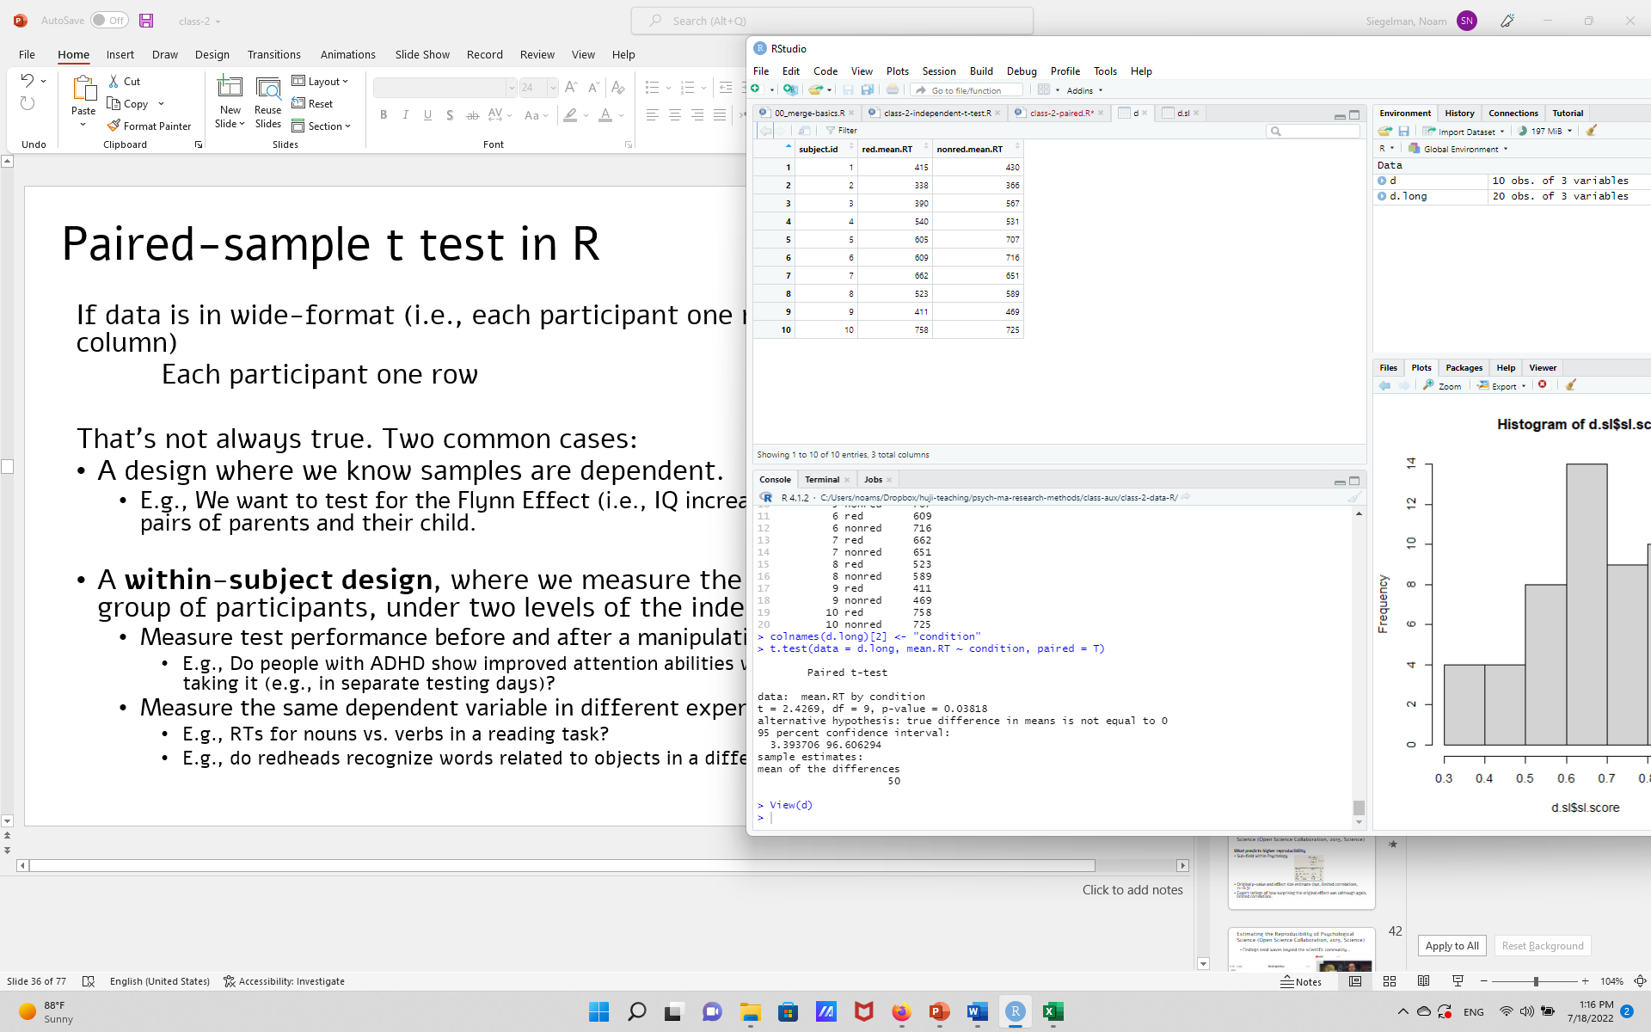
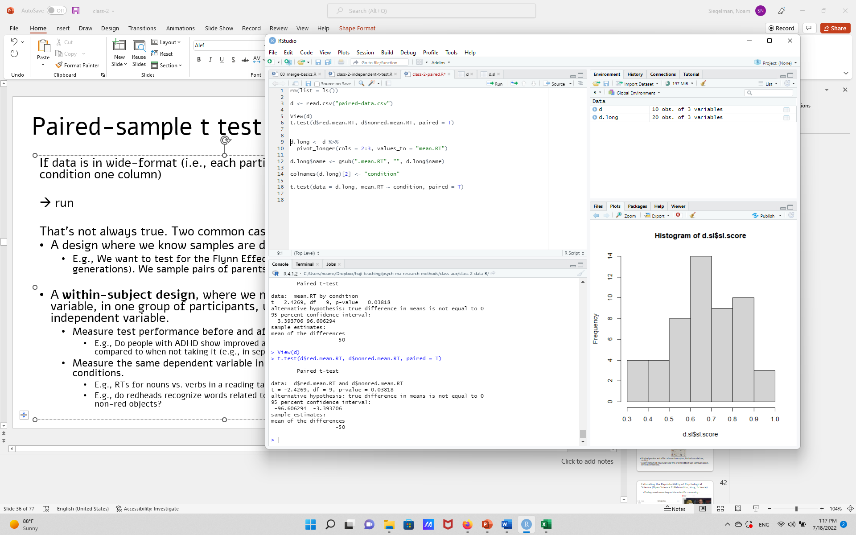
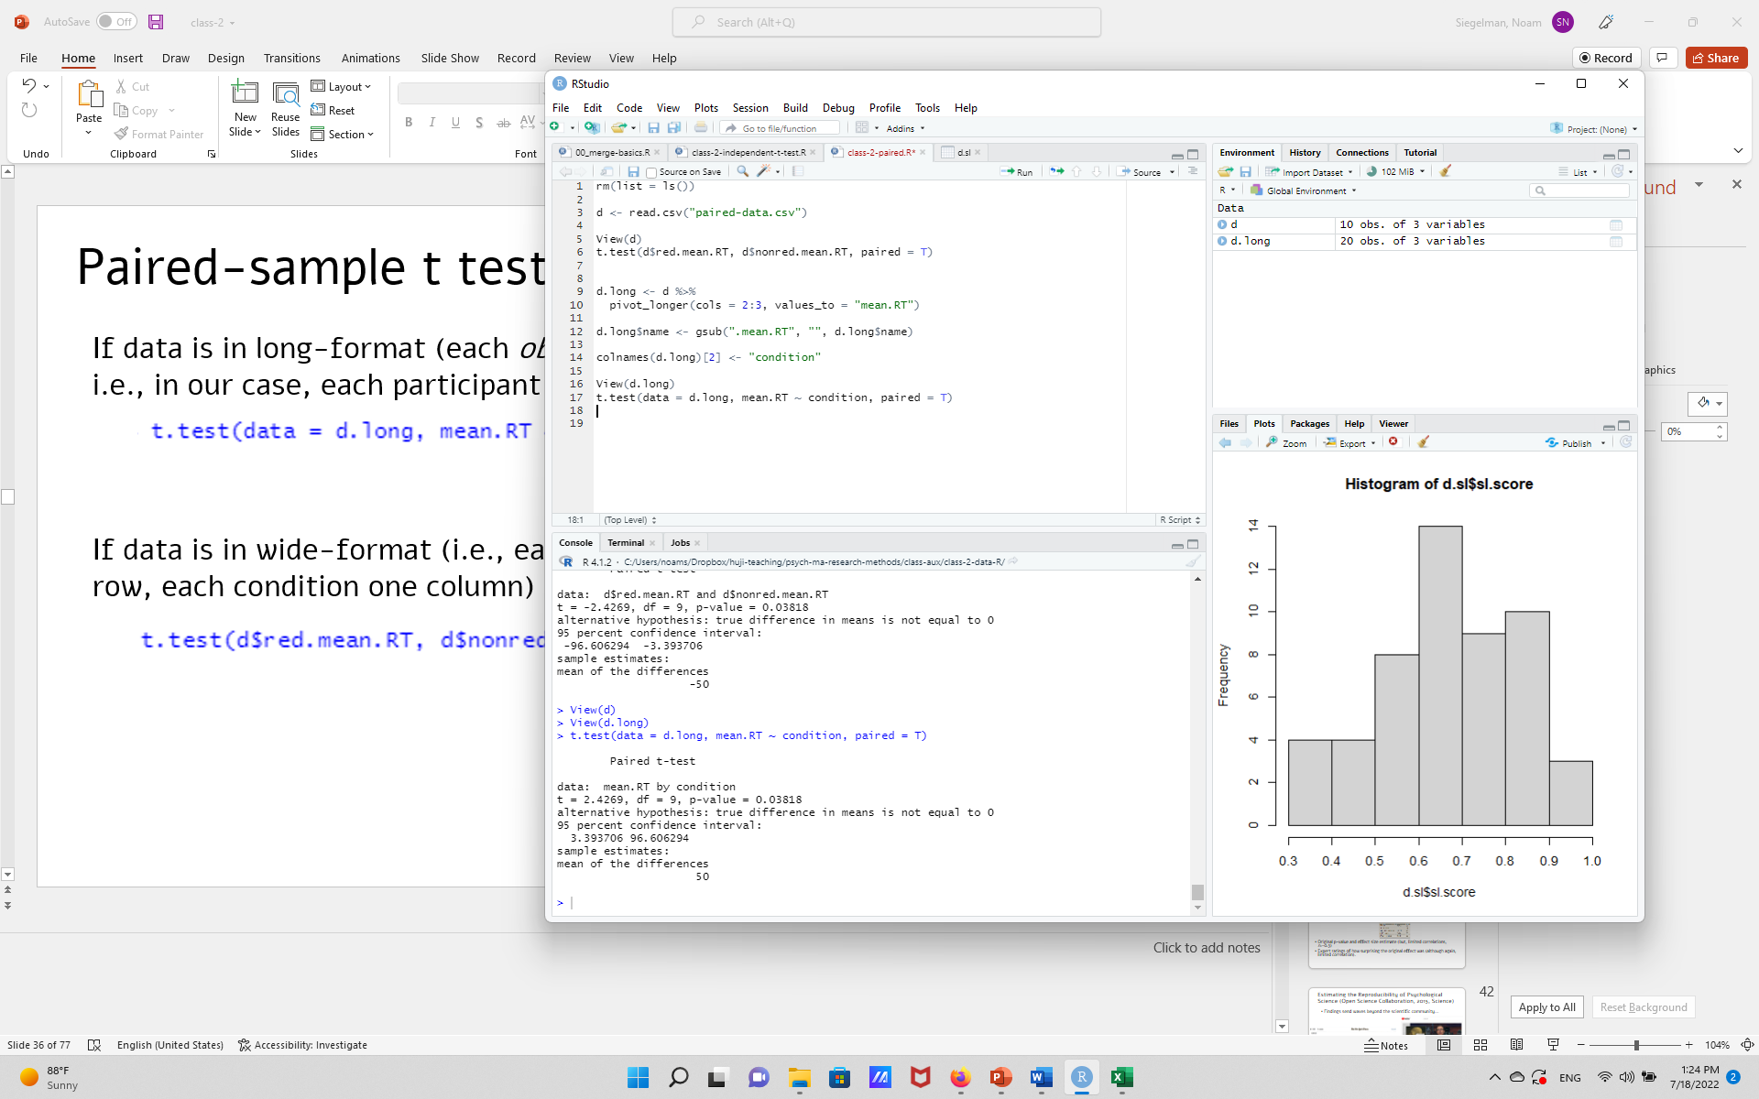
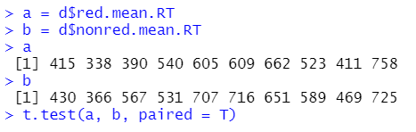
Paired-sample t test in R
Bring data to wide-format (i.e., each participant in one row, each observation/condition in a column).
Then, run the test:
A more general syntax (e.g., for simulations):
But note ordering: a[1] should be paired with b[1], a[2] with b[2], etc.

Slide 38
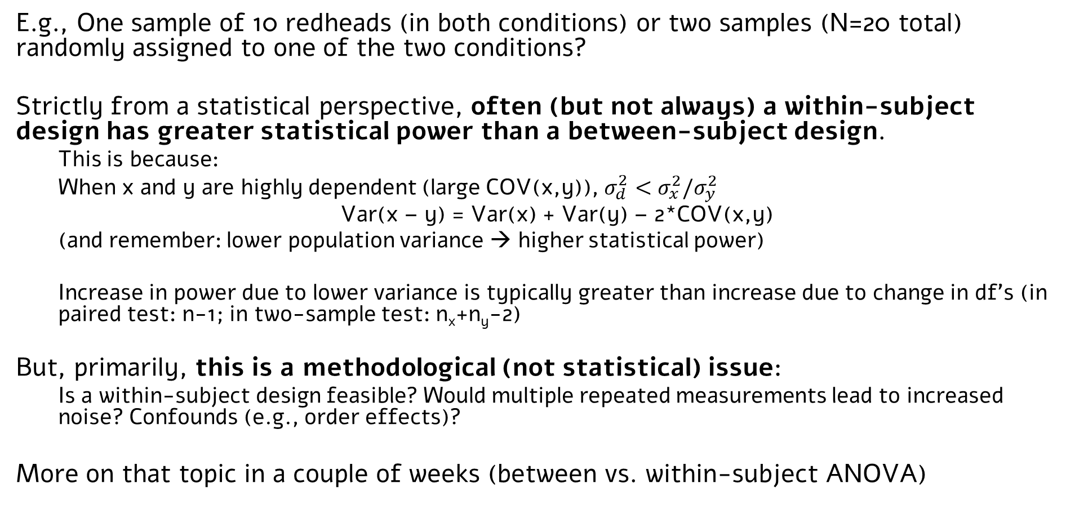
What’s better? Between-subject or within-subject?
E.g., One sample of 10 redheads (in both conditions) or two samples (N=20 total) randomly assigned to one of the two conditions?
Strictly from a statistical perspective, often (but not always) a within-subject design has greater statistical power than a between-subject design.
This is because:
When x and y are highly dependent (large COV(x,y)), $σ_{d}^{2}<σ_{x}^{2}/σ_{y}^{2}$
Var(x – y) = Var(x) + Var(y) – 2*COV(x,y)
(and remember: lower population variance → higher statistical power)
Increase in power due to lower variance is typically greater than increase due to change in df’s (in paired test: n-1; in two-sample test: n_{x}+n_{y}-2)
But, primarily, this is a methodological (not statistical) issue:
Is a within-subject design feasible? Would multiple repeated measurements lead to increased noise? Confounds (e.g., order effects)?
More on that topic in a couple of weeks (between vs. within-subject ANOVA)

Slide 39
Beyond dichotomous inference Confidence intervals Effect size estimates Aka, “the new statistics”

Slide 40
NHST is inherently dichotomous
In typical NHST usage, we derive a binary decision from continuous data.
There is clear appeal to binary decisions: Often we want to get a clear yes/no answer (do we have evidence for an efficient treatment? Is there a difference between groups? Did our manipulation work?)
But there are also clear disadvantages to binary decisions:
It “prompts us to see the world as black and white” (Kline, 2003)
Gives us “a sense of false clarity” (van Deemter, 2010), ignoring the uncertainty in our data.
Related to the “file-drawer problem”.
What should we do?
Option I: Drop binary decisions altogether, only draw probabilistic, continuous, decisions.
Proposed by some people; e.g., the influential paper by Cumming, 2014, here.
(But may be better within alternative statistical frameworks, e.g., Bayesian; more on that later + next semester).
Option II: Keep binary decisions, but complement it with continuous estimates.
My opinion: This is what is happening in the field in practice.
Many journals now publish guidelines along these lines: E.g., American Psychological Association (6th version onwards): “APA stresses that NHST is but a starting point and that additional reporting elements such as effect sizes, confidence intervals, and extensive description are needed”

Slide 41
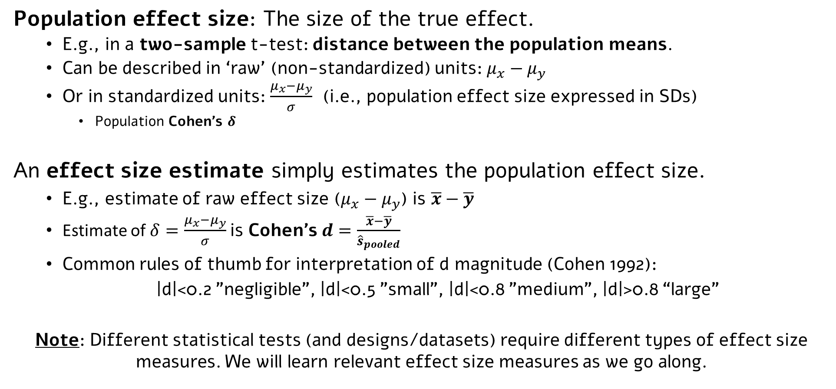
Effect size estimates
Population effect size: The size of the true effect.
E.g., in a two-sample t-test: distance between the population means.
Can be described in ‘raw’ (non-standardized) units: $μ_{x}−μ_{y}$
Or in standardized units: $\frac{μ_{x}−μ_{y}}{σ}$ (i.e., population effect size expressed in SDs)
Population Cohen’s $δ$
An effect size estimate simply estimates the population effect size.
E.g., estimate of raw effect size ($μ_{x}−μ_{y}$) is $\overline{x}−\overline{y}$
Estimate of $δ=\frac{μ_{x}−μ_{y}}{σ}$is Cohen’s $d=\frac{\overline{x}−\overline{y}}{{\hat{s}}_{pooled}}$
Common rules of thumb for interpretation of d magnitude (Cohen 1992):
|d|<0.2 "negligible", |d|<0.5 "small", |d|<0.8 "medium", |d|>0.8 “large”
Note: Different statistical tests (and designs/datasets) require different types of effect size measures. We will learn relevant effect size measures as we go along.

Slide 42
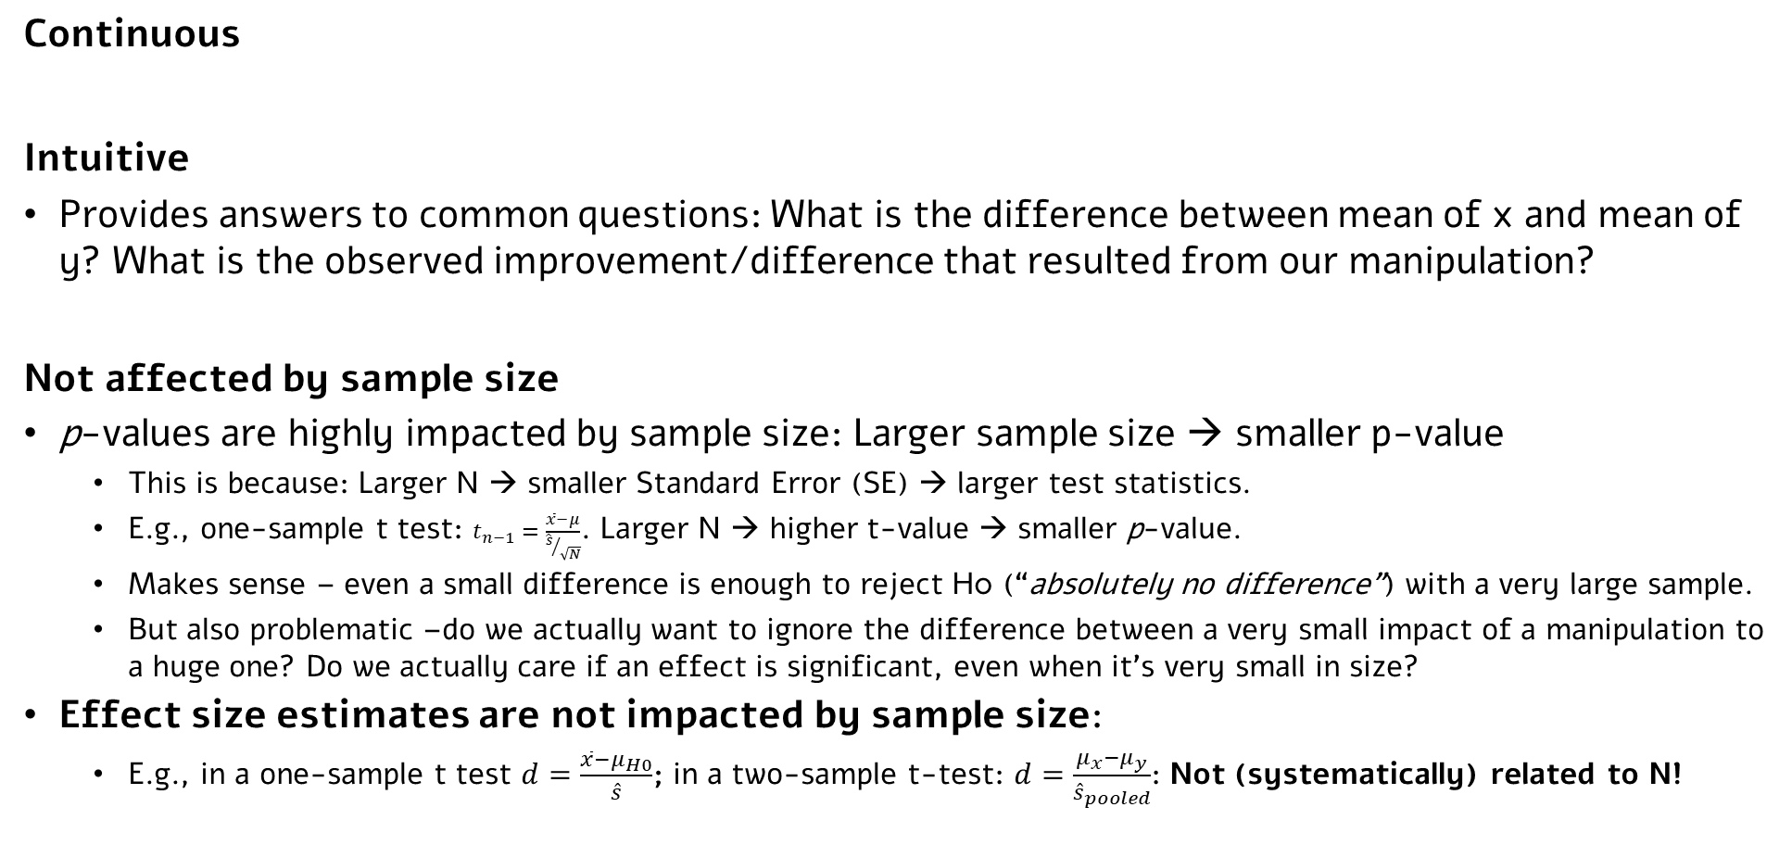
Why add an effect size estimate to your report?
Continuous
Intuitive
Provides answers to common questions: What is the difference between mean of x and mean of y? What is the observed improvement/difference that resulted from our manipulation?
Not affected by sample size
p-values are highly impacted by sample size: Larger sample size → smaller p-value
This is because: Larger N → smaller Standard Error (SE) → larger test statistics.
E.g., one-sample t test: $t_{n−1}=\frac{\overline{x}−μ}{{\hat{s}}/{\sqrt{N}}}$. Larger N → higher t-value → smaller p-value.
Makes sense – even a small difference is enough to reject H0 (“absolutely no difference”) with a very large sample.
But also problematic –do we actually want to ignore the difference between a very small impact of a manipulation to a huge one? Do we actually care if an effect is significant, even when it’s very small in size?
Effect size estimates are not impacted by sample size:
E.g., in a one-sample t test $d=\frac{\overline{x}−μ_{H0}}{\hat{s}}$; in a two-sample t-test: $d=\frac{μ_{x}−μ_{y}}{{\hat{s}}_{pooled}}$: Not (systematically) related to N!

Slide 43
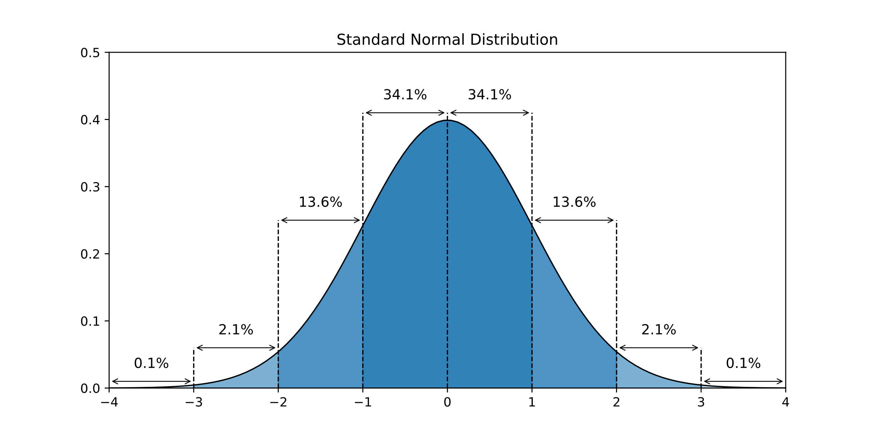
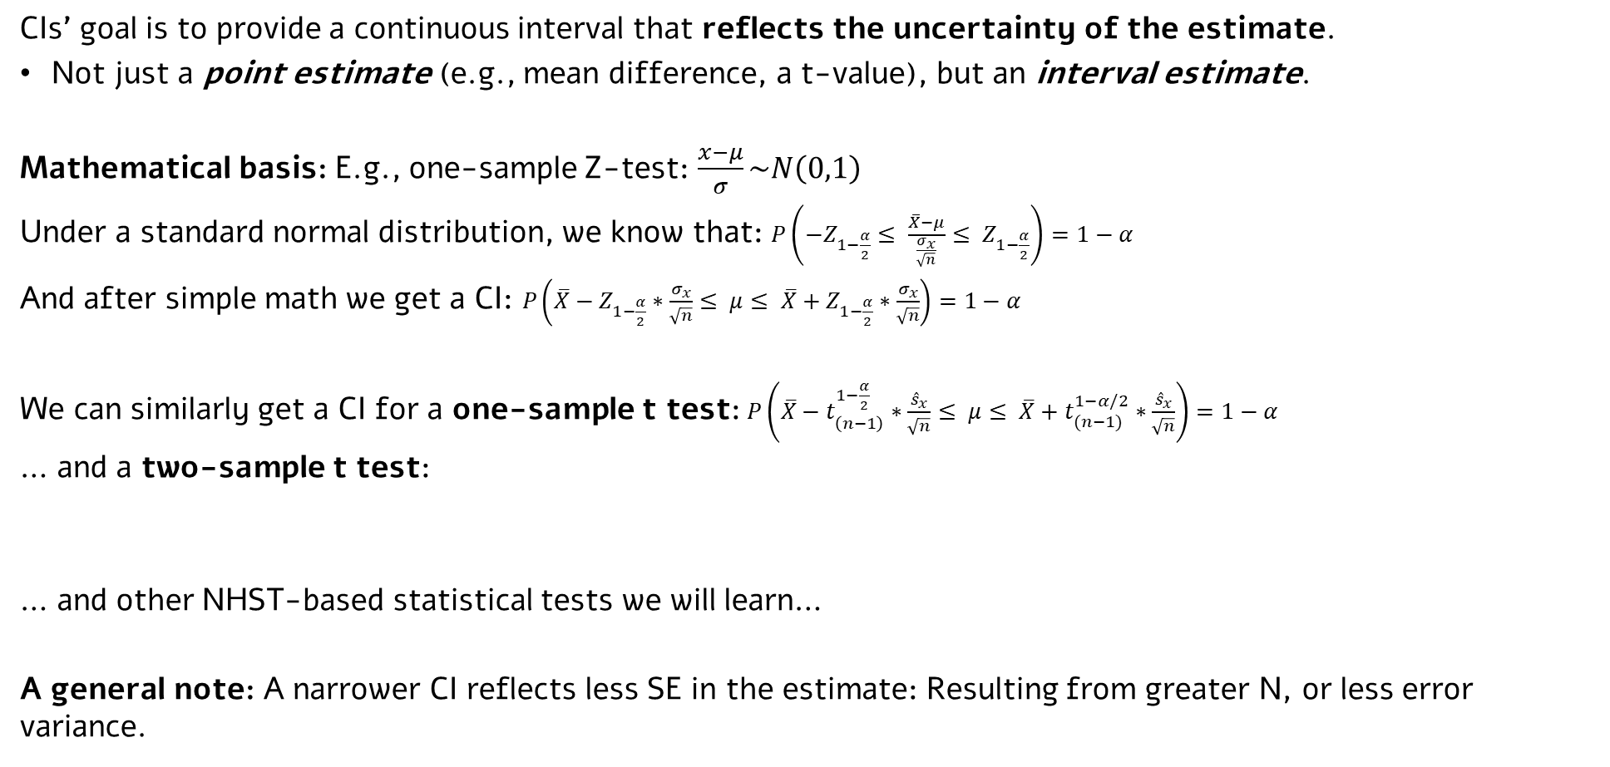
Confidence Interval (CI)
CIs’ goal is to provide a continuous interval that reflects the uncertainty of the estimate.
Not just a point estimate (e.g., mean difference, a t-value), but an interval estimate.
Mathematical basis: E.g., one-sample Z-test: $\frac{x−μ}{σ}\sim N\left(0,1\right)$
Under a standard normal distribution, we know that: $P\left(−Z_{1−\frac{α}{2}}≤ \frac{\overline{X}−μ}{\frac{σ_{x}}{\sqrt{n}}}≤ Z_{1−\frac{α}{2}}\right)=1−α$
And after simple math we get a CI: $P\left(\overline{X}−Z_{1−\frac{α}{2}}∗\frac{σ_{x}}{\sqrt{n}}≤ μ≤ \overline{X}+Z_{1−\frac{α}{2}}∗\frac{σ_{x}}{\sqrt{n}}\right)=1−α$
We can similarly get a CI for a one-sample t test:$P\left(\overline{X}−t_{\left(n−1\right)}^{1−\frac{α}{2}}∗\frac{{\hat{s}}_{x}}{\sqrt{n}}≤ μ≤ \overline{X}+t_{(n−1)}^{1−α/2}∗\frac{{\hat{s}}_{x}}{\sqrt{n}}\right)=1−α$
… and a two-sample t test:
… and other NHST-based statistical tests we will learn…
A general note: A narrower CI reflects less SE in the estimate: Resulting from greater N, or less error variance.

Slide 44
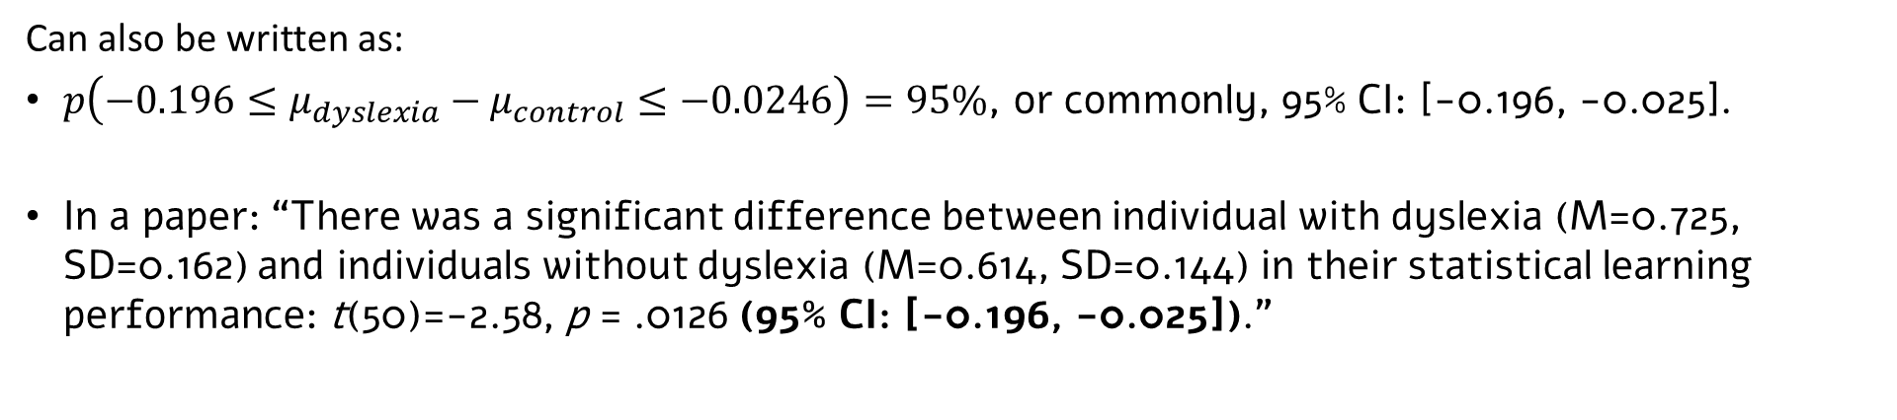
For example
In our SL example (you get CI “for free” in R’s t.test() output!)
Can also be written as:
$p\left(−0.196≤μ_{dyslexia}−μ_{control}≤−0.0246\right)=95\%$, or commonly, 95% CI: [-0.196, -0.025].
In a paper: “There was a significant difference between individual with dyslexia (M=0.725, SD=0.162) and individuals without dyslexia (M=0.614, SD=0.144) in their statistical learning performance: t(50)=-2.58, p = .0126 (95% CI: [-0.196, -0.025]).”

Slide 45

But what does a CI mean?
E.g., $p\left(−0.196≤μ_{dyslexia}−μ_{control}≤−0.0246\right)=95\%$
It does not mean that the parameter ($μ_{dyslexia}−μ_{control}$) is between -0.196 and -0.0246 in a 95% probability. The parameter is a fixed value somewhere in the world; it’s either within the CI or not.
What CI does reflect is a probabilistic claim about the interval: If we were to build an infinite number of intervals, 95% of them would include the actual expected value.
Commonly referred to as “confidence level”.
Hence, for a given interval, there’s a 95% probability that it covers the true value of the parameter of interest (e.g., the true difference in SL abilities between individuals with and without dyslexia).
Again, narrower CI means less uncertainty/smaller SE:
E.g., compare 95% CI: [0.19, 0.21] vs. 95% CI: [0.01, 0.39]

Slide 46

But what does a CI mean?
“The dance of the p-values”
(Cumming, 2008, 2011, 2014; see also YouTube video)
“a single p value gives virtually no information about the infinite sequence of p values.”
Again, p-value is not a measure of evidence strength: It is a tool in making dichotomous decisions!
“[in contrast to p-values], a single CI is informative about the infinite sequence, because its length indicates approximately the extent of bouncing around in the dance.”
Cumming, 2014, Psychological Science
Notes:
Simulated power in this figure 50%
Consider also to include:
What does an experiment tell us about the likely result if we repeat that experiment? For each experiment in Figure 1, note whether the CI includes the mean of the next experiment. In 20 of the 24 cases, the 95% CI includes the mean next above it in the figure. That is 83.3% of the experiments, which happens to be very close to the long-run average of 83.4% (Cumming & Maillardet, 2006; Cumming, Williams, & Fidler, 2004). So a 95% CI is an 83% prediction interval for the ES estimate of a replication experiment. In other words, a CI is usefully informative about what is likely to happen next time.
Now consider NHST. A replication has traditionally been regarded as “successful” if its statistical-significance status matches that of the original experiment—both ps < .05 or both ps ≥ .05. In Figure 1, just 9 of the 24 (38%) replications match the significance status of the experiment immediately below, and are thus successful by this criterion. With power of .50, as here, in the long run we can expect 50% to be successful. Even with power of .80, only 68% of replications will be successful. This example illustrates that NHST gives only poor information about the likely result of a replication.

Slide 47

Another interpretation of CI
Refresher: There’s a link between dichotomous NHST decision and CI
When reject H0 <-> parameter under H0 not in interval.
When not reject H0 <-> parameter under H0 is in interval.
(Assuming identical procedure: E.g., same $α$, two-tailed procedure in both).
→ Another CI interpretation:
An interval containing all values of the parameter that wouldn't be rejected when serving as the parameter under H0.
E.g., in our example: 95% CI: [-0.196, -0.025]:
We did reject a H0 stating that the difference is 0.
We wouldn’t reject a H0 where the stated difference is 19.59%, 19%, 18%, … 2.51%. We would reject a H0 where the difference is 1%, 2%, 2.49%.
Notes:
if the parameter under H0 is included in CI, we will not reject the H0; if it isn’t included in the CI we will reject H0.

Slide 48


CI for an effect size
CI can be used as an interval estimate (not just point estimate) for many different parameters:
Expected value of one population
Difference between expected values
(also the unstandardized effect size)
(many examples as we go along)
We can similarly build CIs for different effect size estimates (e.g., Cohen’s d, and others)
Often seen in meta-analysis.
In R:
Pan & Sana, 2021
(or any other meta-analysis ☺)
(Look at ?cohens_d for alternatives to using pooled SD!)

Slide 49
Summary: Confidence intervals and effect sizes
Instead of saying: “There was a significant difference between individuals with dyslexia (M=0.725, SD=0.162) and individuals without dyslexia (M=0.614, SD=0.144) in their statistical learning performance: t(50)=-2.58, p = .0126”
Say: “There was a significant difference between individual with dyslexia (M=0.725, SD=0.162) and individuals without dyslexia (M=0.614, SD=0.144) in their statistical learning performance: t(50)=-2.58, p = .0126 (95% CI: [-0.196, -0.025]; Cohen’s d = -0.72, 95% CI for d: [-1.30, -0.14]).”
Discuss the implications of your study based on CIs and effect size estimates, not just significance.
Relatedly, remember what p-value means (and what it doesn’t): It is a tool for making a dichotomous inference regarding a certain value of the parameter.
Common misconception: “my result is ‘highly’ significant, hence the effect is probably huge!”
CI and effect size estimates complement the dichotomous NHST decision:
An interval, not just point estimate.
A measure of the error (uncertainty) in the estimate.
An intuitive measure of the size of the effect (and potentially, its practical significance).
Complement with figures that show raw data and reflect uncertainty (e.g., SE, CI).

Slide 50

Summary: Confidence intervals and effect sizes
Dyslexia-control SL example:
Created using ggbarplot() from the ggpubr package.

Slide 51
Cumming, 2014: An eight-step new-statistics strategy for research with integrity
Formulate research questions in estimation terms. To use estimation thinking, ask “How large is the effect?” or “To what extent . . . ?” Avoid dichotomous expressions such as “test the hypothesis of no difference” or “Is this treatment better?”
Identify the ESs that will best answer the research questions. If, for example, the question asks about the difference between two means, then that difference is the required ES […]. If the question asks how well a model describes some data, then the ES is a measure of goodness of fit.
Declare full details of the intended procedure and data analysis. Prespecify as many aspects of your intended study as you can, including sample sizes. A fully prespecified study is best.
After running the study, calculate point estimates and CIs for the chosen ESs. [E.g.], For Experiment 1 […] the estimated difference between the means is 16.9, 95% CI [6.1, 27.7].
Make one or more figures, including CIs. […] use error bars to depict 95% CIs.
Interpret the ESs and CIs. In writing up results, discuss the ES estimates, which are the main research outcome, and the CI lengths, which indicate precision. Consider theoretical and practical implications, in accord with the research aims.
Use meta-analytic thinking throughout. Think of any single study as building on past studies and leading to future studies. Present results to facilitate their inclusion in future meta-analyses. Use meta-analysis to integrate findings whenever appropriate.
Report. Make a full description of the research, preferably including the raw data, available to other researchers. […] Be fully transparent about every step, including data analysis—and especially about any exploration or selection, which requires the corresponding results to be identified as speculative.

Slide 52
Cumming, 2014: An eight-step new-statistics strategy for research with integrity
Formulate research questions in estimation terms. To use estimation thinking, ask “How large is the effect?” or “To what extent . . . ?” Avoid dichotomous expressions such as “test the hypothesis of no difference” or “Is this treatment better?”
Identify the ESs that will best answer the research questions. If, for example, the question asks about the difference between two means, then that difference is the required ES […]. If the question asks how well a model describes some data, then the ES is a measure of goodness of fit.
Declare full details of the intended procedure and data analysis. Prespecify as many aspects of your intended study as you can, including sample sizes. A fully prespecified study is best.
After running the study, calculate point estimates and CIs for the chosen ESs. [E.g.], For Experiment 1 […] the estimated difference between the means is 16.9, 95% CI [6.1, 27.7].
Make one or more figures, including CIs. […] use error bars to depict 95% CIs.
Interpret the ESs and CIs. In writing up results, discuss the ES estimates, which are the main research outcome, and the CI lengths, which indicate precision. Consider theoretical and practical implications, in accord with the research aims.
Use meta-analytic thinking throughout. Think of any single study as building on past studies and leading to future studies. Present results to facilitate their inclusion in future meta-analyses. Use meta-analysis to integrate findings whenever appropriate.
Report. Make a full description of the research, preferably including the raw data, available to other researchers. […] Be fully transparent about every step, including data analysis—and especially about any exploration or selection, which requires the corresponding results to be identified as speculative.
Notes:
In green – points just discussed.
In orange – to be discussed in the remainder of the semester.
In pink–additional points for thought

Slide 53
More on the new(er ☺) statistics
How common “new statistics” practices actually are? (2017 paper, 2020 update).
https://thenewstatistics.com/itns/2022/03/17/open-science-practices-patchy-progress-in-two-psychology-journals/
From new statistics to better science: A simple and easy-to-read paper with additional practical lessons (2019).
https://www.ncbi.nlm.nih.gov/pmc/articles/PMC6874217/
Post p-value education in graduate statistics: How to teach stats in our time.
https://psycnet.apa.org/record/2020-58797-001
Andrew Gelman’s blog: Many things re stats in psychology, inc. best practices.
https://statmodeling.stat.columbia.edu/

